Slide 1
Bell County Road & Bridge Safety Program

Slide 2
Safety Awards Program
Overview
Safety Officer’s role
Safety Incentives
Accident/Incident Reporting
Safety Review Committee
Road and Bridge Handbook

Slide 3
Safety Awards Program Overview
Started in 2007
Commissioner’s Court Approved
County received Safety Gold Award from the Texas Association of Counties in 2015.

Slide 4
Safety Officer’s Role
Selection of SRC(Safety Review Committee) members
Conduct quarterly safety meetings for all crews
Organize accident/incidents packages for SRC review
Summarize SRC results to present to County Engineer
Conduct all safety classes including, welding certification, flagging certification, coordination of defensive driving classes, discuss Road and Bridge Handbook with new employees
Plan and organize annual safety banquet

Slide 5
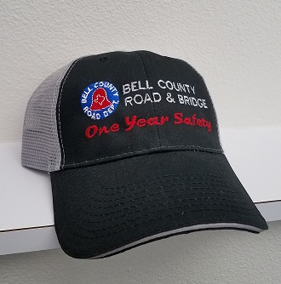
Safety Incentives
Status | Individual Award
First Year | Cap, Certificate, ½ day off
2-4 Consecutive Years | Certificate, 1 day off
5th Year | Jacket, Certificate, 1 day off
6-9, 11-14th | Certificate, 2 days off
10 and 15th Years | Certificate, 3 days off
Status | Crew Award
Quarterly Crew Award | ½ day off
Annual Crew Award | ½ day off
Annually | ½ day off

Slide 6
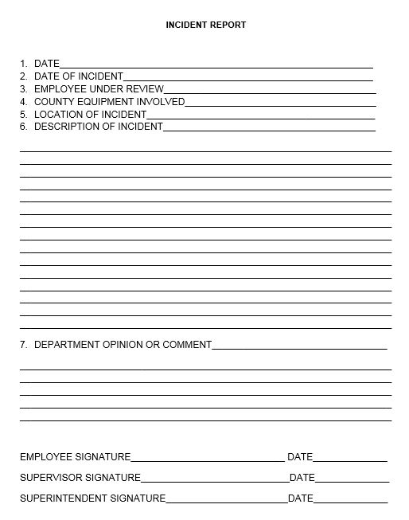
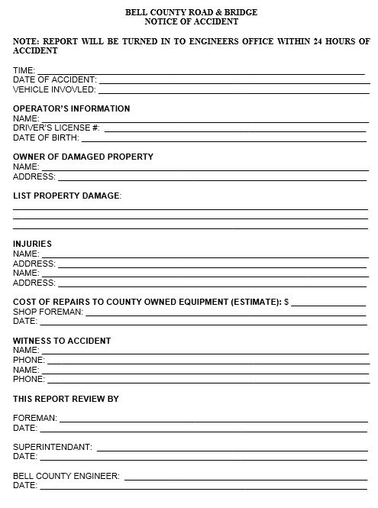
Accident/Incident Reporting
Incident reports are submitted as soon as possible.
Employee’s signature
Supervisor’s signature
Superintendent’s signature
County Engineer’s signature on Notice of Accident

Slide 7
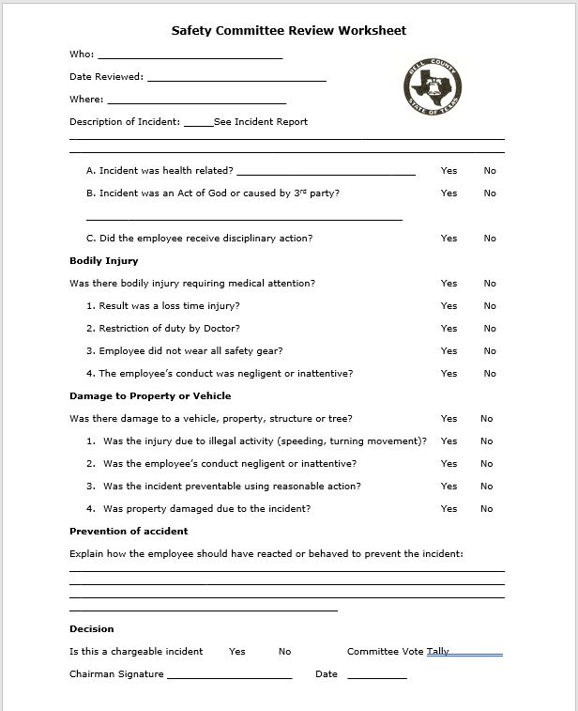
Safety Review Committee
Safety officer appoints note taker and foreman to fill out and tally votes on all cases.
Brief explanation and comments of discussion are added by committee.
1 member from each Road and Bridge crew plus 1 foreman and 1 member representing Engineers office.

Slide 8
Road and Bridge Handbook
Safety officer reviews handbook with all new employees
Handbook covers safety issues including;
Regulations
Personal Protective Equipment
Seal Coat Operations
Defensive Flagging
Heat Stress
Lifting and Carrying
Equipment Safety
Shredding Guidelines
Welding and Cutting Torch Safety Guidelines
Poisonous plants, snakes and insects
Emergency contacts

Slide 9
Quarterly Safety Meetings
Safety Officer’s role
All crews are required to attend
Quest speakers are used periodically
Various topics

Slide 10
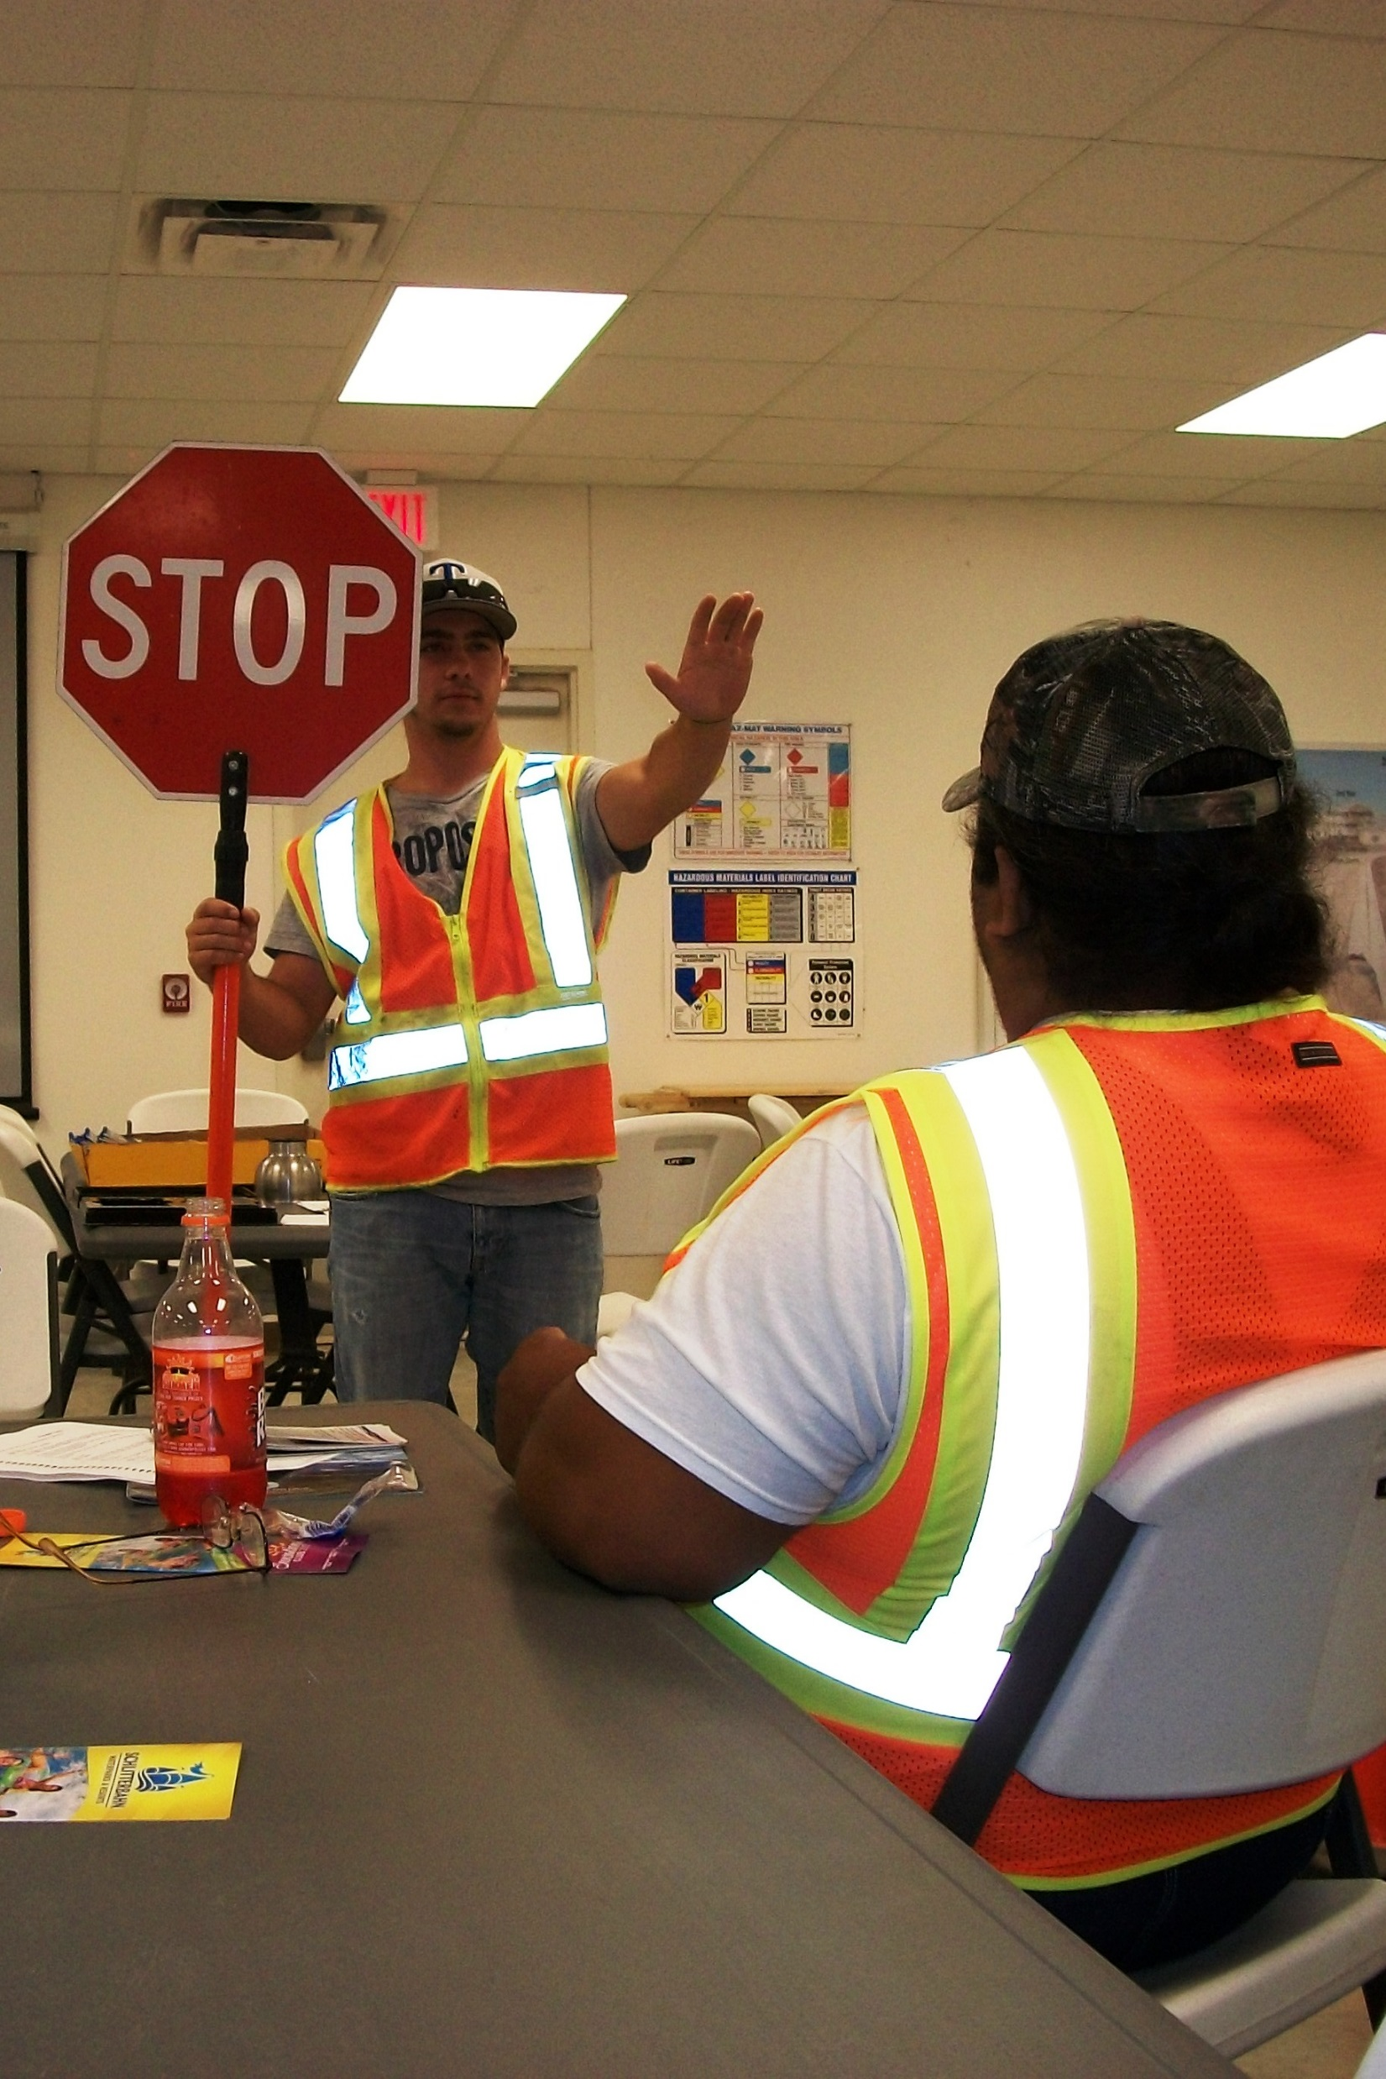
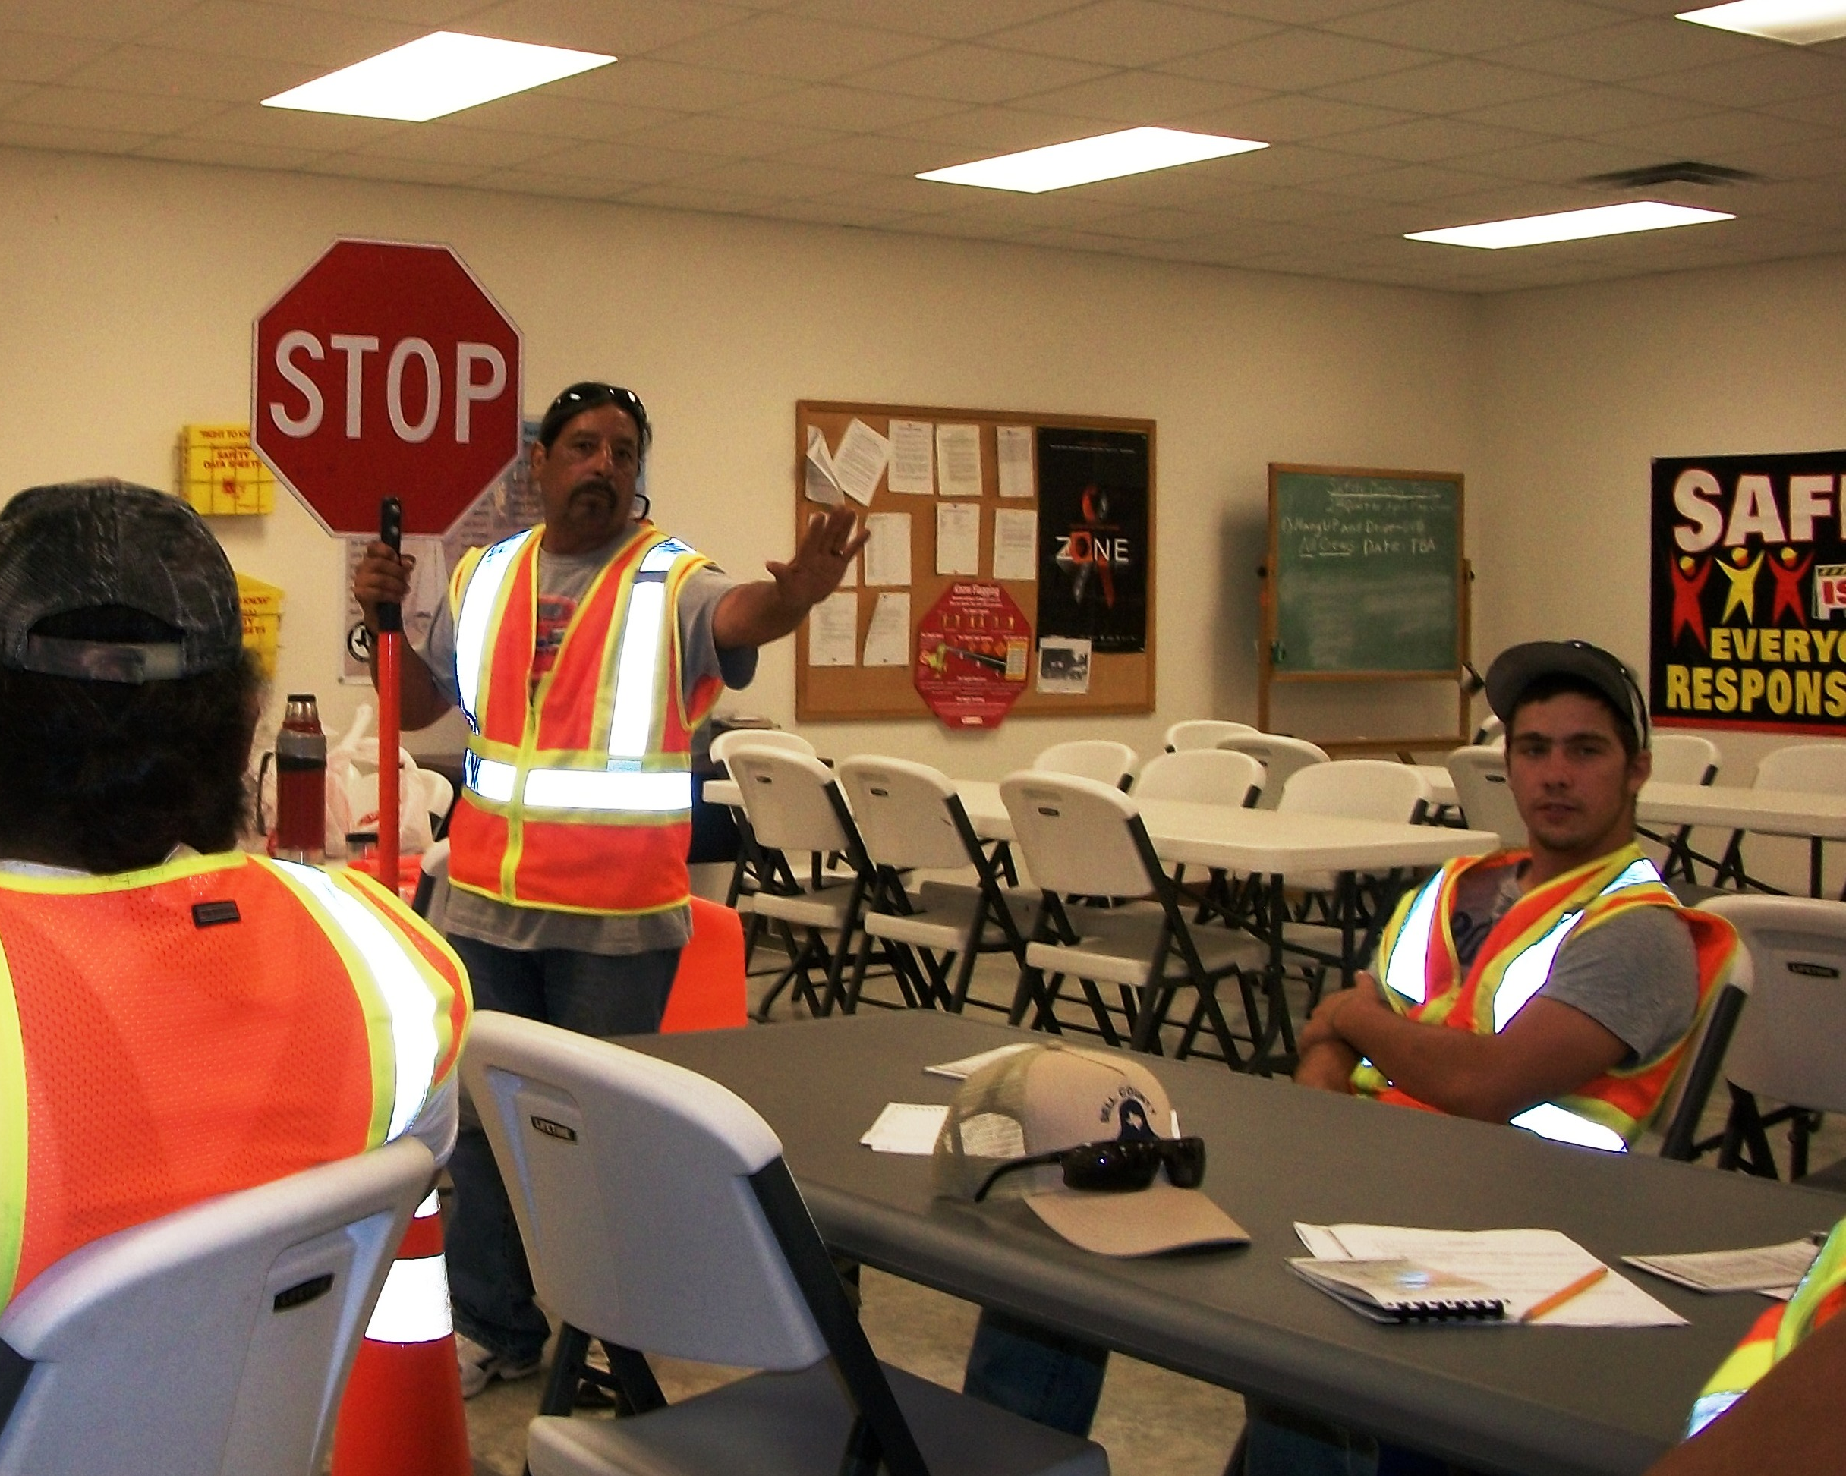
Flagger Certification
Safety Officer’s role
Course description

Slide 11
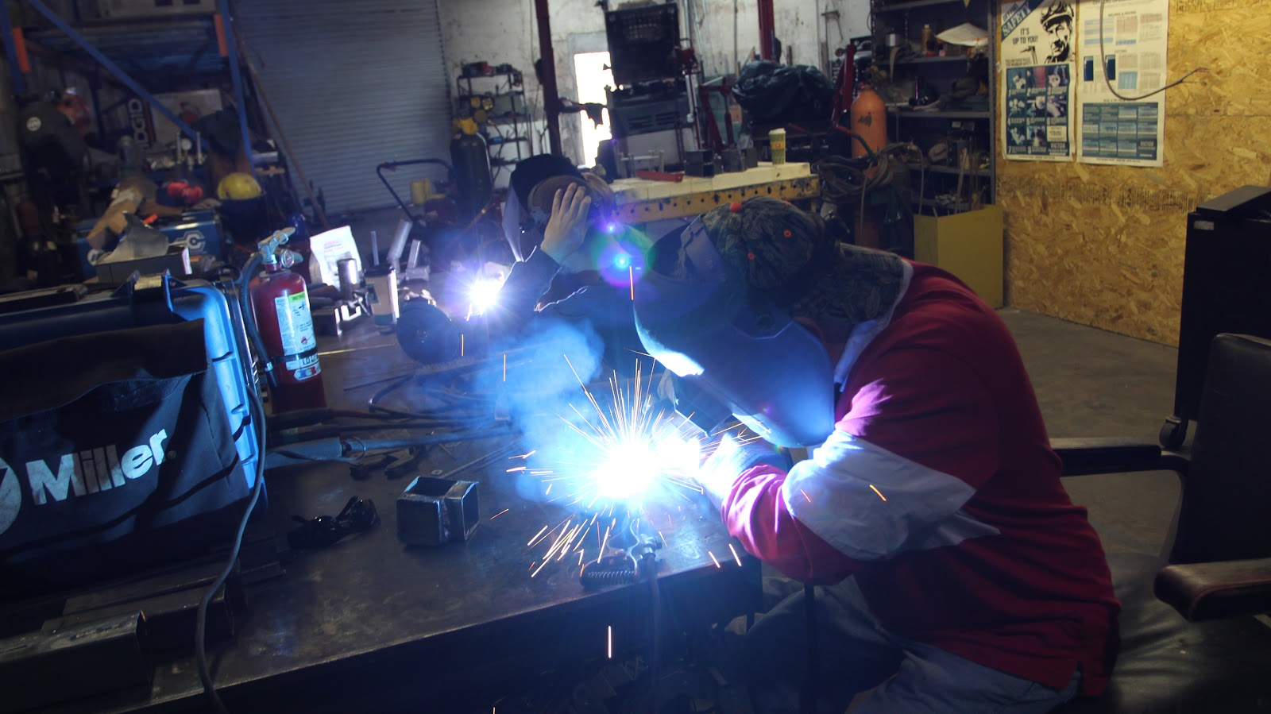
Welding Course
Safety Officer’s role
Course description

Slide 12
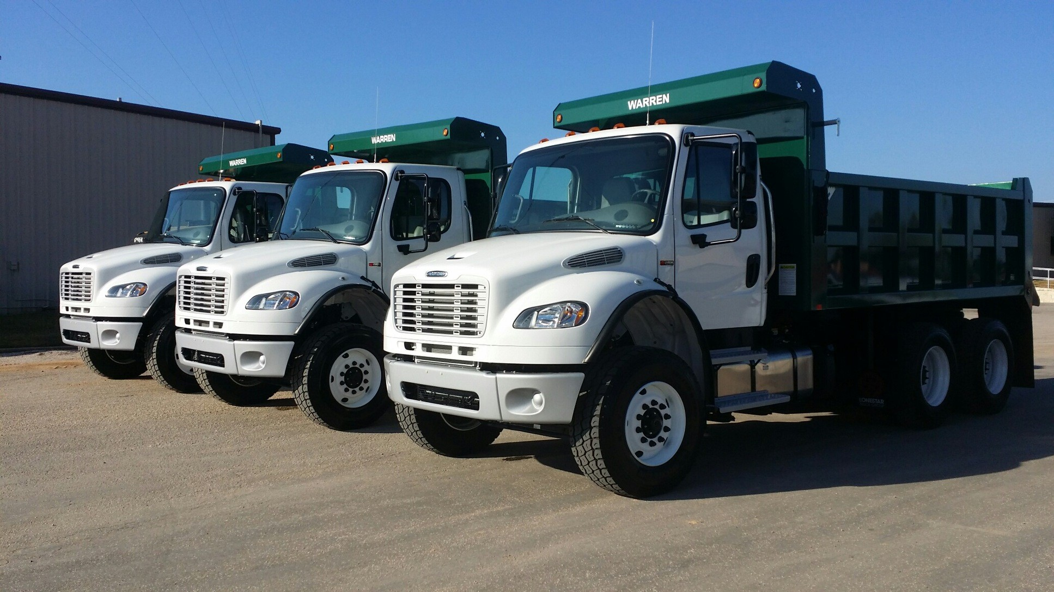
Vehicle Inspection Sheet
Collection and Management
Spreadsheet updates
Advantages of maintenance records

Slide 13
Seasonal Kick-off Meetings
Seal Coat Meeting
Asphalt Crew
Hauling and Pits Crew
Shredding Meeting
Blading and Shredding Crew
New equipment acquisition

Slide 14
Annual Safety Awards Banquet
Annual crew awards
Annual individual awards
Consecutive safe years awards
Gifts

Slide 15
Q & A

