Slide 1
TORT LIABILITY
AVOID LAWSUITS: PROTECT ROADWAY USERS & THE COUNTY
Presented by: David Hearnsberger, The University of Texas at Arlington

Slide 2
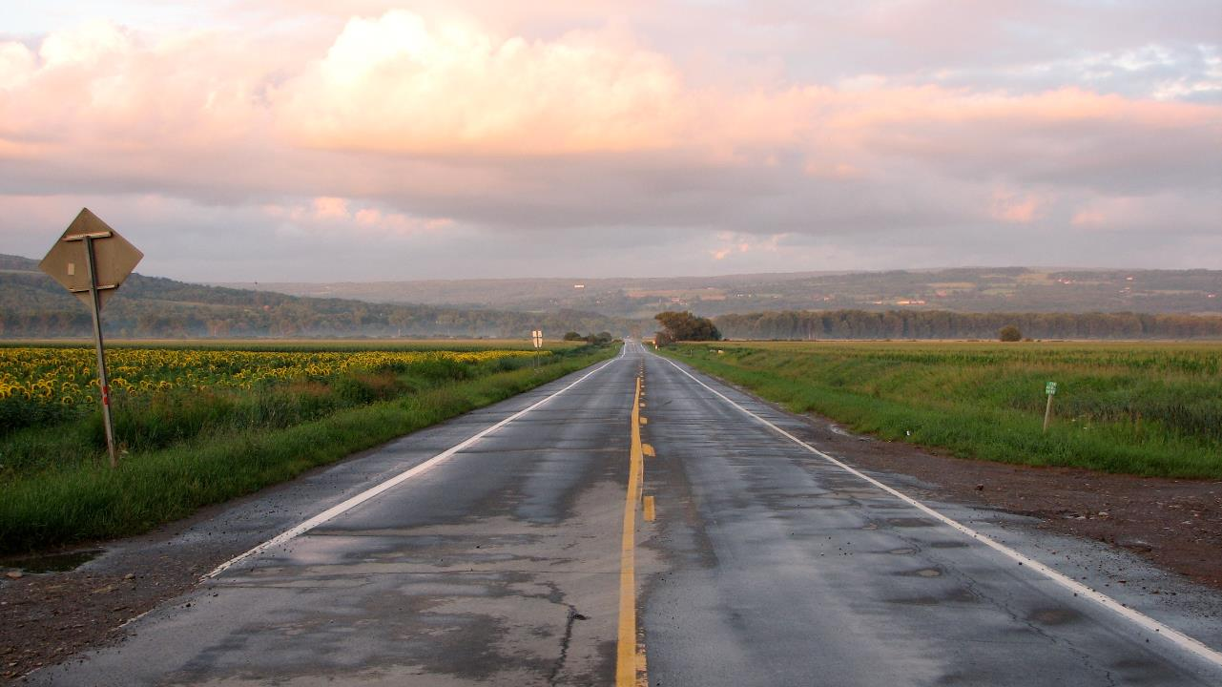
Local road agencies have significant responsibilities:
Notes:
In Texas, the management of the state’s roadway system falls to three main groups.

Slide 3
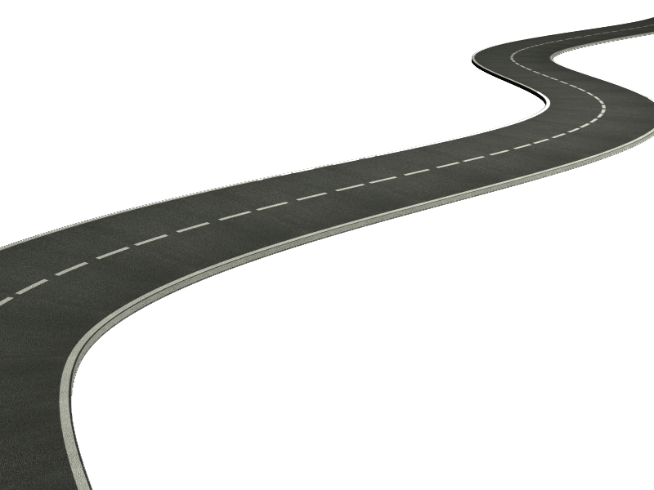
313,210 total road miles in Texas
Notes:
With over 300,000 miles of roads, counties have the lion’s share of the responsibility.

Slide 4
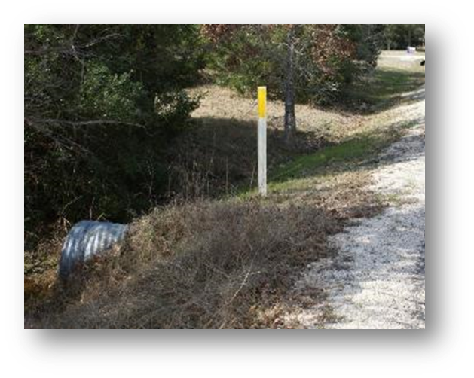
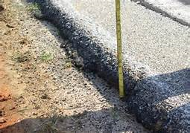
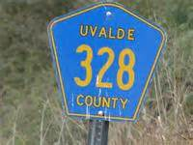
Road Infrastructure
Notes:
In addition to the actual roads, counties are also saddled with managing bridges, culverts, and signage for their vast systems. All of this infrastructure presents legal exposure for counties as motorist, cyclist or pedestrian could be involved in an accident on your road at anytime.

Slide 5
Road Maintenance
Notes:
Along with all the infrastructure issues to keep tabs on, counties have maintenance projects which also expose them to risk and potential law suits should a traffic accident occur. Take this photo for instance. Could this be Negligence or Contribute to an Accident?
Definitely! This is a MAJOR encroachment into the traveled way. There is NO traffic control in view. This could be ruled as negligence because a normal person would have taken additional steps to guide traffic around the work zone.
Speaking of work zones…

Slide 6
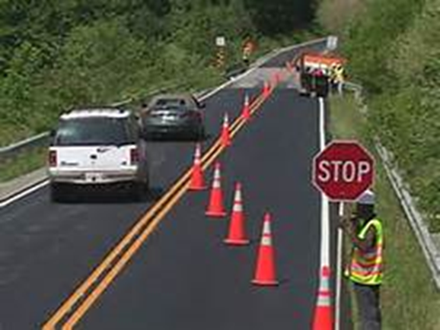
WORK Zones
Notes:
They present another area where counties are exposed to high risk. In 2014, there were 670 incapacitating injuries, 2,948 non-incapacitating injuries and 146 fatalities. 14 road workers were killed in work zones last year. They present unique challenges for drivers which make them ripe for trying to lay blame on others and hence lawsuits are filed. Some of those challenges involve:
Sight distance issues;
Confusing / improper / lack of signs;
Positive guidance issues;
Confusing traffic control devices;
Hazards on or next to the road;
Clear zone issues;
Pavement drop-off issues

Slide 7
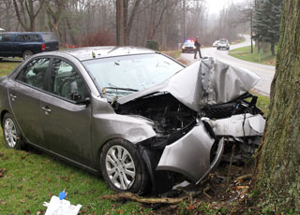
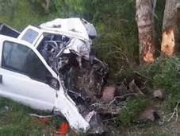
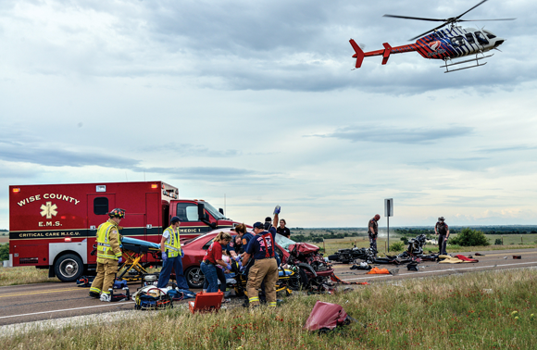
  "The weeds were so tall that I could not see anything traveling down the road."
  "There were not any signs warning me of this problem."
  "I hit the pothole and lost control and hit the other car.“
Notes:
Often these situations lead to expensive lawsuits especially if the victim believes someone or something with deep pockets is at fault.

Slide 8

Notes:
Before we move on, lets watch a video to get the feel for a lawsuit a county might have brought against it.
While it would be nearly impossible for a county to eliminate every potential exposure, it can manage risk and take proactive steps to protect itself and roadway users. I hope you saw many, many things the county worker did wrong in the video. His actions were obviously high risk and exposed the county a great deal. He, nor the county, used “reasonable care” when maintaining Fraser Road.

Slide 9

Reasonable standard of care
Notes:
Key phrases in any lawsuit which seeks to determine negligence are “reasonable standard of care” or “reasonable care”. Reasonable care is the degree of caution and concern an ordinarily prudent and rational person would use in similar circumstances. It is a standard used to determine a legal duty and whether such duty was fulfilled. Reasonableness is a subjective test used determine if a person or organization failed to exercise reasonable care.
While reasonableness is subjective, there are prudent steps a county should take to protect itself from lawsuits.

Slide 10
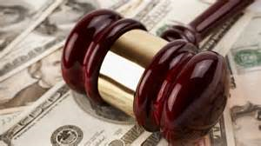
But Wait…we’re the county
Notes:
Now you may be saying to yourself, Now hold up, I work for the county and we can’t be sued. WRONG. The Texas Tort Claims Act essentially removed the blanket of immunity from roadway-related tort liability. As such the county and you, personally, can be sued for negligence in a lawsuit.

Slide 11
General risk Reduction strategies
  Qualified and Trained Staff
  Policies, Procedures, Standards, and Guidelines
  Accident Reduction Program
  Roadway Improvement Program
  Collection, Evaluation, and Investigation of Accident Data
  Documentation and Recordkeeping

Slide 12
Qualified and Trained Staff
A critical consideration in any public agency's risk management program is to provide qualified and capable personnel to perform agency duties in a responsible manner.
Public agency employees owe a duty to the public to provide a reasonable "standard of care."
  If an agency is operating with unqualified, incompetent personnel, it will be more difficult to provide a reasonable “standard of care.”
Notes:
If such care is not exercised, the agency and/or responsible employees may be held liable.

Slide 13
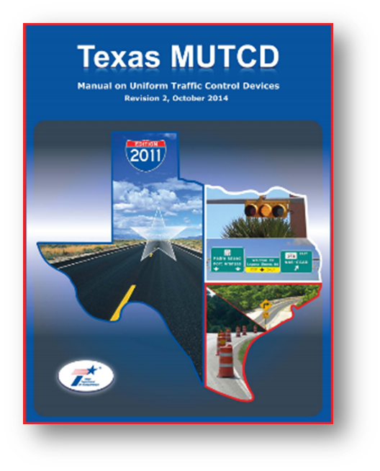
Policies, Procedures, Standards, and Guidelines
One of the best ways to mitigate risk is to make sure you understand and carry out policies, procedures, standards, and guidelines.

Slide 14
Policies, Procedures, Standards, and Guidelines
Employees are expected to follow guidelines and procedures adopted by the agency.
The adoption of relevant standards, policies, and manuals is necessary and useful to:
  Define the manner in which activities are performed.
  Ensure a consistent degree of quality and safety of work.
PERIODICALLY REVIEW GUIDELINES!
Notes:
If written policies and procedures are not followed, it will be relatively easy for a plaintiff's attorney to establish that a reasonable standard of care was not exercised. Strict adherence to these documents will not absolutely guarantee that lawsuit claims will not occur, but in a court of law, however, testimony that rules and guidelines were being followed will help prove “reasonableness.”

Slide 15
Traffic Accident Reduction Program
One of the key goals in risk management is to minimize the probability and impact of threats, thus reducing the potential for losses.
An accident reduction program is an effective device to minimize risks. "Reduction“ includes reduction of one or more of the following measures:
  Number of accidents
  Frequency of accidents
  Severity of accidents
Notes:
The focus of an accident reduction program is to reduce accidents, thus reducing the number of threats motorists may face.
This need not be a complex program, but some mention of a counties activities to identify high risk areas will help protect the county from being found negligent especially when combined with the next step- implementing a Roadway Improvement Program

Slide 16
Roadway Improvement Program
A roadway improvement program differs from an accident reduction program. Here’s how:
  An accident reduction program is concerned with generating a number of alternative improvement options (opportunities).
  A roadway improvement program is concerned with selecting and implementing the improvement option which will most effectively minimize the counties’ tort liability (response planning).
Notes:
A counties' roadway improvement program is normally directly related to the organization’s accident reduction program.
In most cases, the process of reducing accidents generally involves some type of physical improvement to the roadway.

Slide 17
Roadway Improvement Program
Presumably the most "accident-prone" areas will be corrected in a timely manner, funding permitted, with a resulting reduction in the number of tort claims.
A properly documented priority ranking system for roadway improvements will afford protection for the agency in a court of law.

Slide 18
Collection, Evaluation, and Investigation of Traffic Accident Data
A "high-exposure" accident is an accident that has a high probability of a lawsuit.
  Generally, all fatal accidents should be considered as "high-exposure" accidents.
  Collecting information about these types of accidents can be useful in preventing future accidents as well as beneficial during a lawsuit.

Slide 19
Collection, Evaluation, and Investigation of Traffic Accident Data
Routine inspections of high-exposure accident areas are a method of minimizing the problems associated with attempting to recreate accident scenes many months after the date of the accident.

Slide 20
Collection, Evaluation, and Investigation of a Traffic Accident Data
Knowing specifics about the scene such as:
  What the surrounding area looked like at the time of the accident.
  Which traffic control devices were in place.
  How the roadway or intersection was designed.

Slide 21
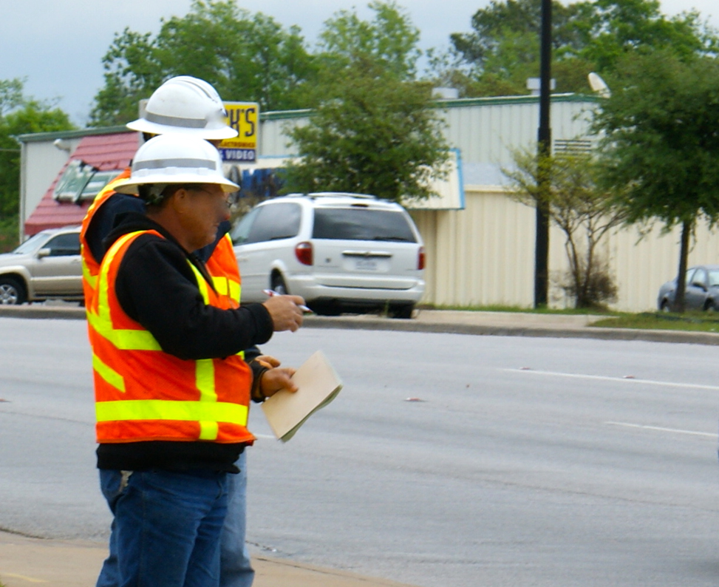
Documentation and Recordkeeping
Be Proactive!
Maintain a maintenance log
Keep a journal of maintenance meetings and items discussed
Document safety trainings
Maintain inspection logs
Take photos of the work zone
USE FACTS, NOT OPINIONS!

Slide 22
Inspections
The following items should be included in your documentation:
  Date and time the inspection was conducted
  Results of inspection
  Need for repair
  Time the repair was completed
  What repairs were made
Notes:
Such documentation is useful as evidence of the agency’s reasonable and prudent manner in maintaining a safe roadway system for the public.

Slide 23

Provide Local Agencies with Free:
Classroom Training
Hands on Technical Assistance
Website with Videos, Newsletters, Lending Library, and Equipment Checkout
817-272-9678
txltap@uta.edu
www.uta.edu/ded

