Slide 1
ARE YOU READY?
Preparing your staff to respond to emergencies

Slide 2
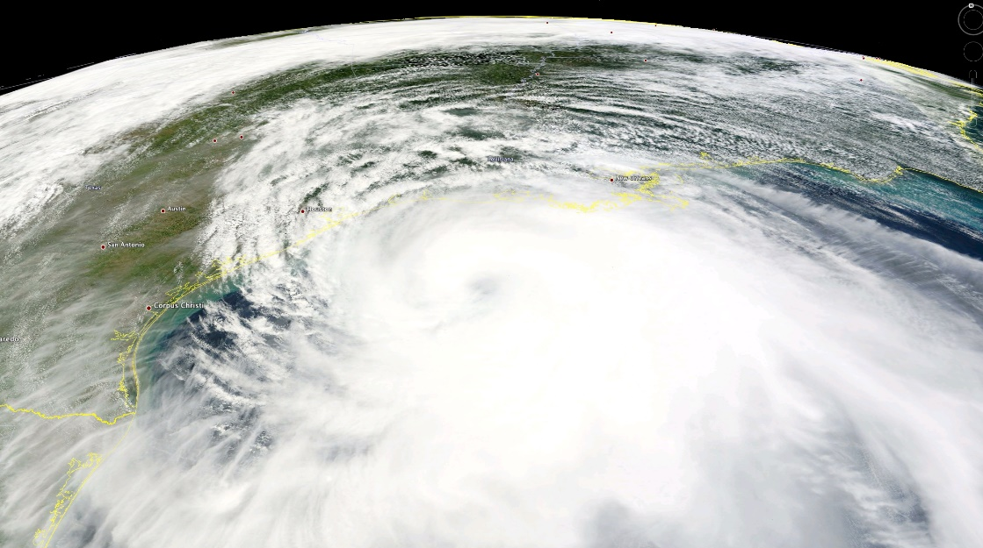
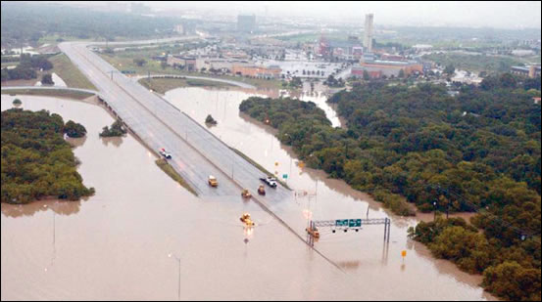
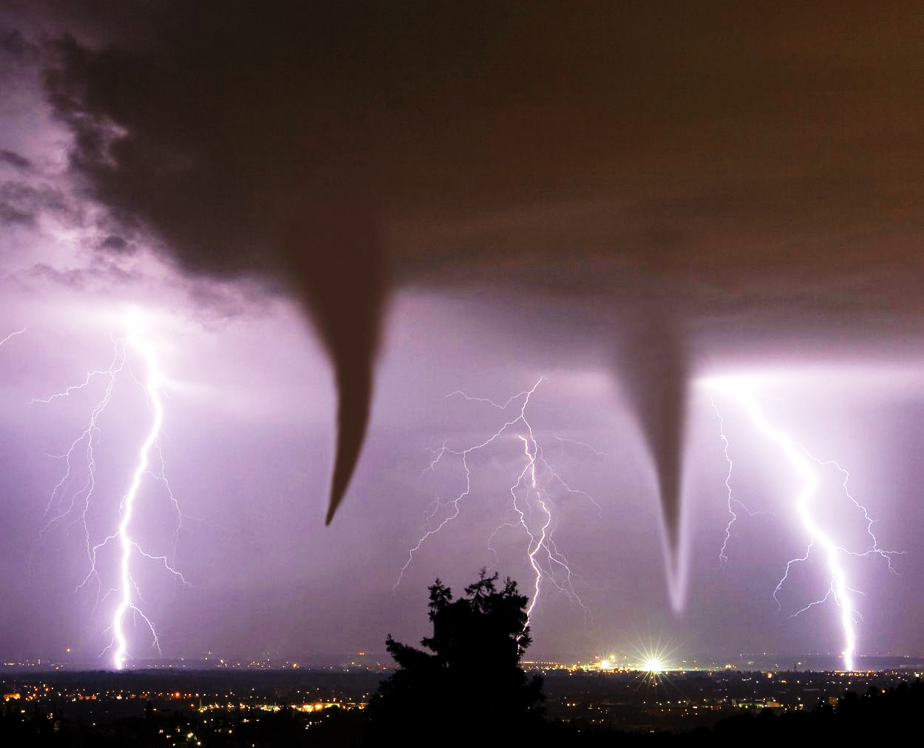
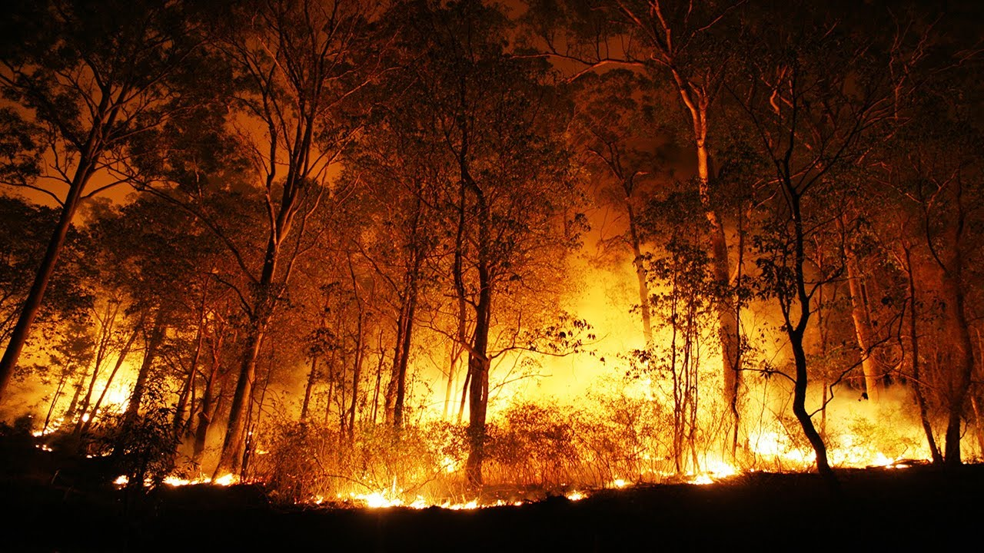
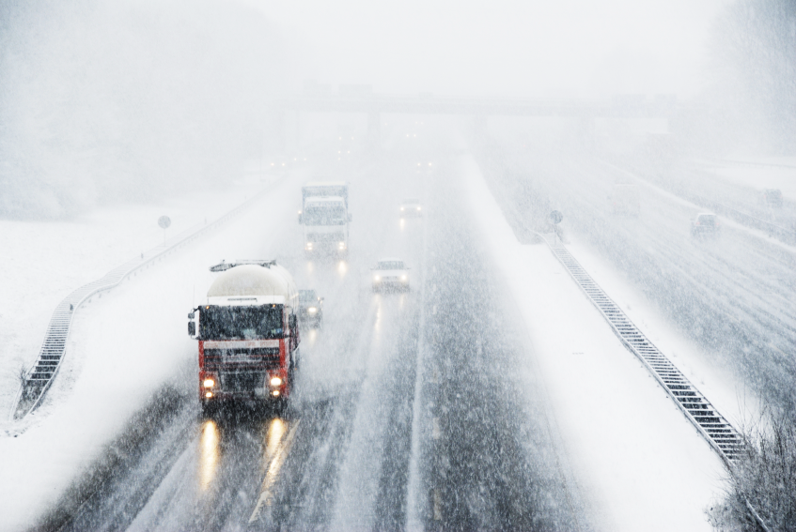
Types of Emergencies

Slide 4
The Cycle of Emergency Preparedness

Slide 5
Two Critical Elements
Leadership
Communication

Slide 6
Critical Truth #1
In a crisis, employees will most always look to their leadership for help and answers.

Slide 7
Critical Truth #2
In a crisis, employees will usually work together to solve problems.

Slide 8
Critical Truth #3
How you manage immediately before, during, and after a crisis will most likely cement your reputation and your ability to lead in the future.

Slide 9
SUCCESS DEPENDS
ON YOUR PLANNING

Slide 10
The 3 P’s
PLAN
Make a plan.
PREPARE
Prepare for the “What if’s.”
PRACTICE
Practice your plan.

Slide 11
PLANNING STRATEGY
PRE-DISASTER
POST-DISASTER

Slide 12
PLANNING STRATEGY
PRE-DISASTER
POST-DISASTER

Slide 13
Pre-disaster

Slide 14
PRE-DISASTER
Which emergencies or disasters?
Emergency plan
Supplies
Responsibilities of family members
Important documents
Pets

Slide 15
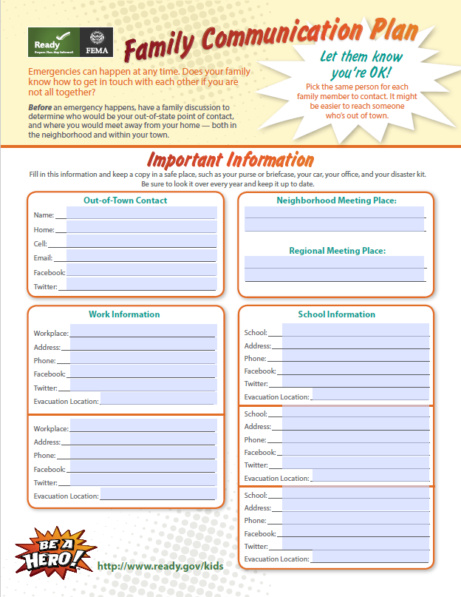
PRE-DISASTER
Go/No Go
Evacuation strategy
Contact information
Critical documents

Slide 16
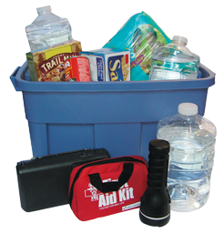
Prepare Your Kit
Food / water
Personal items
Supplies for babies and children
Clothing and bedding
Communication equipment
Lighting - flashlights

Slide 17
Important Documents
Insurance papers
School records
Birth certificates
Contact information
Social Security cards
Cash

Slide 18
Mentally / Physically
Maintain a healthy lifestyle.
Make a plan.
Get supplies together.
Test equipment.

Slide 19
Mentally / Physically
Absence from family
Challenging work conditions
Long work-days
Dealing with the loss
Prepare your family

Slide 20
Family Responsibility
Include everyone.
Spread out responsibilities.
Notify everyone of any changes.
Make time to review and practice the plan.

Slide 21
Pets
Make a plan for pets.
Gather supplies.
Transportation
Housing

Slide 22
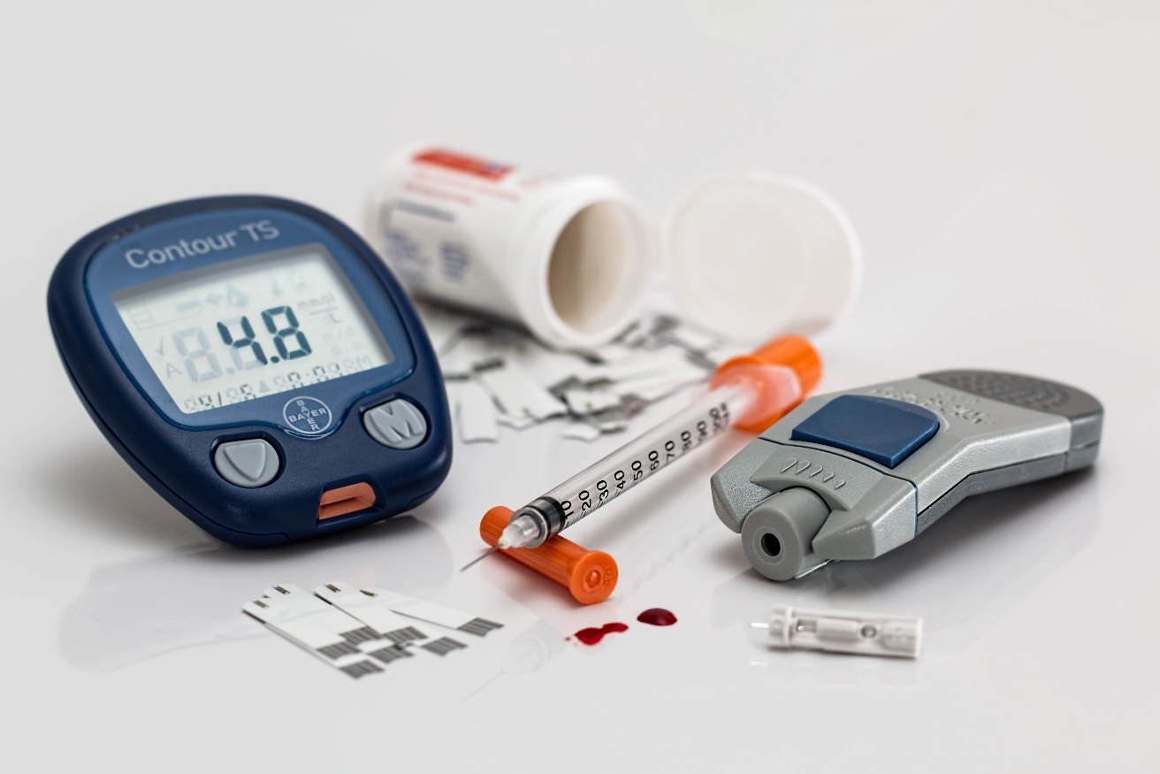
Medical Supplies
Prescriptions/medicines
CASH – Lots of it
Over-the-counter supplies
Insurance papers

Slide 23
Practice Your Plan!

Slide 24
Post-disaster

Slide 25
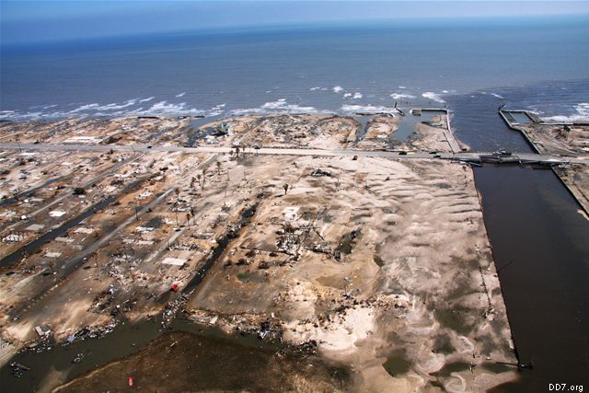
Hurricane Ike
Bolivar Peninsula, TX

Slide 26
Family Communications
Update!!!
Social media
Emergency Notification Systems
Websites
Phones
Communications

Slide 27
Public Communications
Closed counties/cities
Water system updates
Electricity updates
Businesses operating

Slide 28
Public Communications
Social media
“Blackboard Direct”
Websites
Broadcast/print media

Slide 29
Training
Updated safety training
Updated work training
NIMS training
Specialized training
Cross-training
Communications

Slide 30
Logistics
Work with EMC/EOC
NO “Lone Rangers”
Finance/Procurement

Slide 31
Logistics
Lodging
Sleeping in office?
Temporary shelter?
”On your own?”

Slide 32
Logistics
Food & Water
Catered?
MRE’s?
”On your own?”

Slide 33
Logistics
Information Systems
Cloud backup
Portable drives
Laptops/tablets
Always backup!

Slide 34
Logistics
Pay
Cash
Vouchers
”On Your Own?”

Slide 35
Logistics
Sanitation and Laundry
Portable toilets
Showers
Contract launderer

Slide 36
Personnel
Updated email & phone list
Telecommuting
Accountability personnel

Slide 37
Safety
PLAN
PREPARE
PRACTICE

Slide 38
Safety
NIEHS
National Institute of
Environmental Health Sciences
www.niehs.nih.gov

Slide 39
Safety
Temperature

Slide 40
Safety
Temperature
Noise

Slide 41
Safety
Temperature
Noise
Injury/Illness

Slide 42
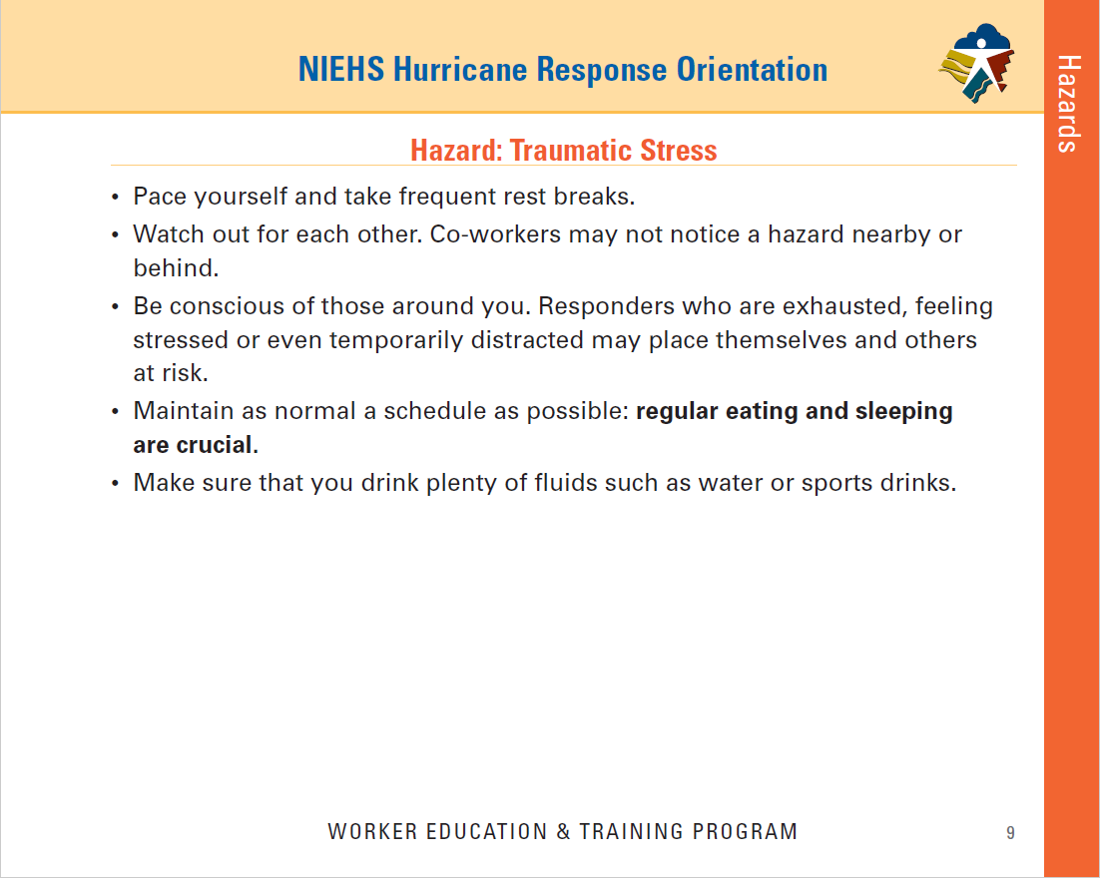
Safety
Temperature
Noise
Injury/Illness
Stress

Slide 43
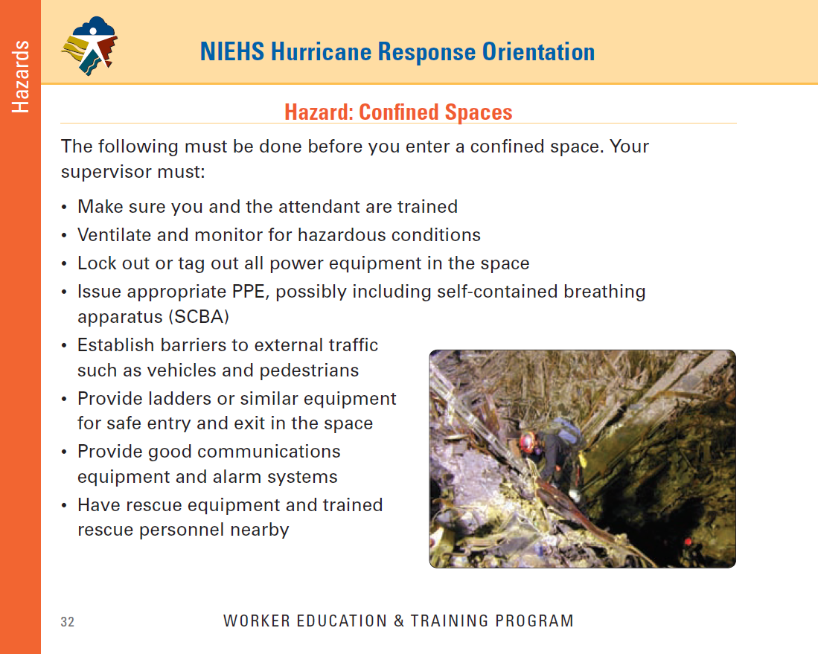
Safety
Temperature
Noise
Injury/Illness
Stress
Confined Spaces

Slide 44
Safety
Temperature
Noise
Injury/Illness
Stress
Confined Spaces
Chainsaws

Slide 45
Personal Protective Equipment
Use proper PPE.
Check with your Safety Officer.
Maintenance and inspection
Follow manufacture’s recommendation.
Inspect PPE.

Slide 46
Personal Protective Equipment
Clean all PPE after use.
Repair/replace damaged or broken PPE.
Store in clean dry air – free from exposure to sunlight or contaminants.

Slide 47
Personal Protective Equipment
Training
Proper fit, wear, and maintenance.
Ensure training explains that explains when and what PPE should be worn and why.

Slide 48
Putting it all Together
Disasters are challenging and stressful.
Leadership and Communication are imperative.
Develop a Strategy and Plan for Pre/Post Disaster.
The 3 P’s.
PLAN
PREPARE
PRACTICE

Slide 49
Provide Local Agencies with Free:
Classroom Training
Hands on Technical Assistance
Website with Videos, Newsletters, Lending Library, and Equipment Checkout
817-272-9678
txltap@uta.edu www.uta.edu/ded

