Slide 1
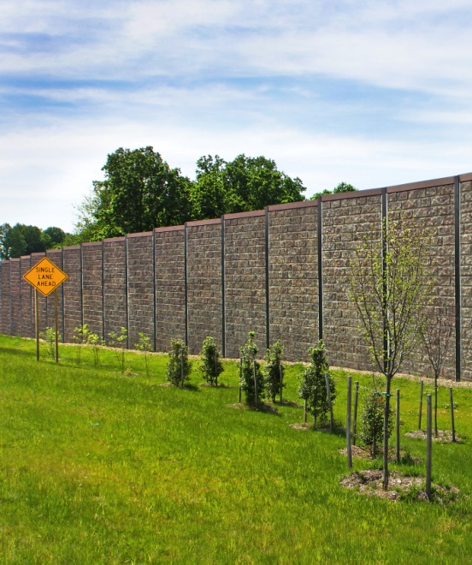
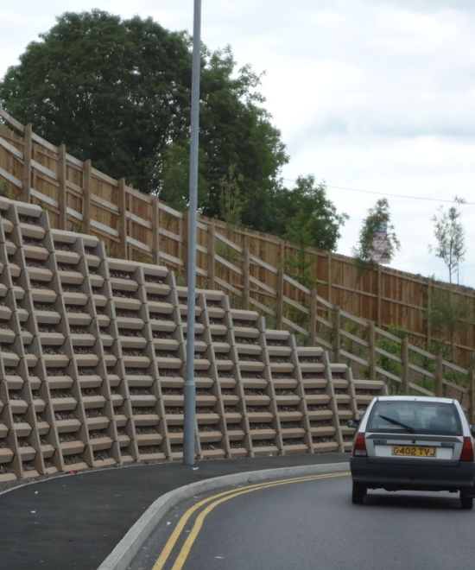
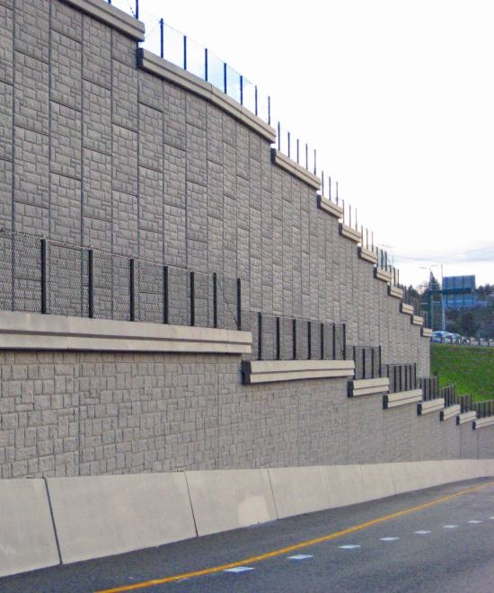
Retaining Wall Types (And Their Application)
Thomas M. Vick, P.E., PMP
TTL, Inc.
TACERA Fall Conference
October 17, 2018

Slide 2
Retaining Wall Types and Their Application
Terminology
Externally vs. Internally Stabilized
Wall Types
Four main types
Retaining Wall Uses
Wall Selection
Retaining Wall Stability
Modes of Failure

Slide 3
Terminology
A retaining wall is a structure that holds or retains material (usually soil) behind it. There are many types of materials that can be used to create retaining walls like concrete blocks, poured concrete, treated timbers, rocks or boulders. Some are easy to use, others have a shorter life span, but all can retain soil.

Slide 4
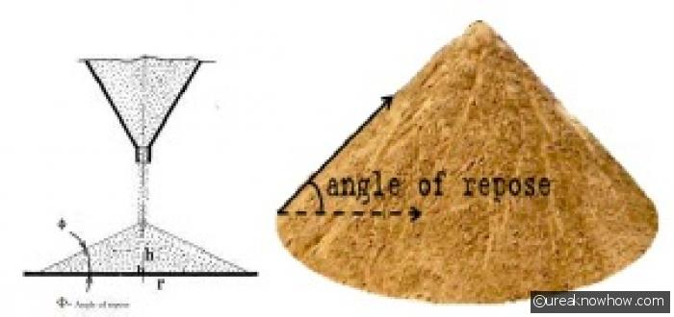
Terminology

Slide 5
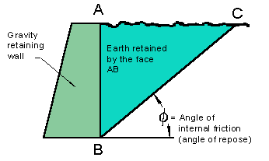
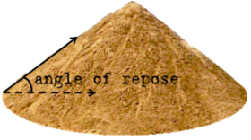
Terminology

Slide 6
Terminology

Slide 7
Externally vs Internally Stabilized

Slide 8
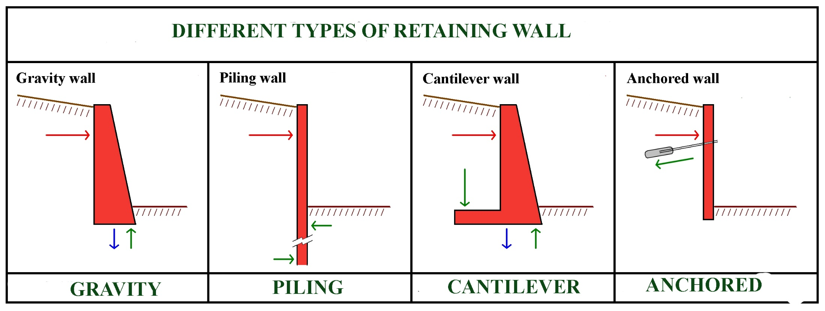
Wall Types

Slide 9
Gravity Walls
Gravity walls depend on their mass (stone, concrete or other heavy material) to resist pressure from behind and may have a 'batter' setback to improve stability by leaning back toward the retained soil. For short landscaping walls, they are often made from mortarless stone or segmental concrete units (masonry units).

Slide 10
Gravity Walls

Slide 11
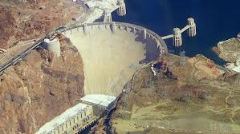
Gravity Walls – Concrete Cast

Slide 12
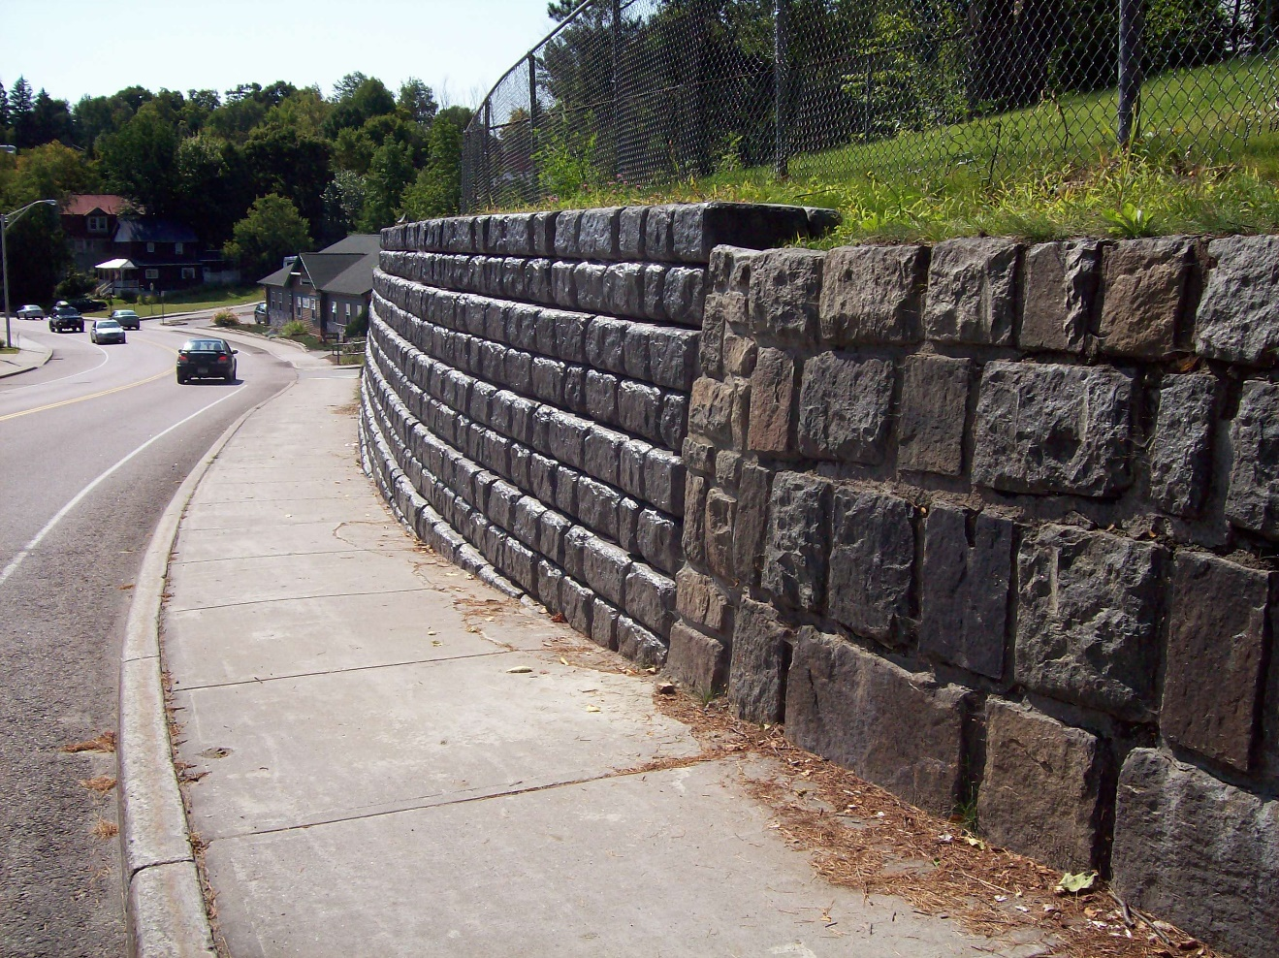
Gravity Walls - Segmental

Slide 13
Gravity Walls – Gabion Walls

Slide 14
Gravity Walls - Segmental

Slide 15
Gravity Walls – SRW

Slide 16
Cantilevered Walls
Cantilever retaining walls are constructed of reinforced concrete. They consist of a relatively thin stem and a base slab. The base is also divided into two parts, the heel and toe. The heel is the part of the base under the backfill.

Slide 17
Cantilevered Walls – Diagram

Slide 18
Cantilevered Walls –Cast in Place

Slide 19
Cantilevered Walls – Precast

Slide 20
Piling Walls
Sheet pile retaining walls are usually used in soft soil and tight spaces.
Sheet pile walls are made out of steel, vinyl or wood planks which are driven into the ground.
For a quick estimate the material is usually driven 1/3 above ground, 2/3 below ground, but this may be altered depending on the environment.
Bored pile retaining walls are built by assembling a sequence of bored piles, proceeded by excavating away the excess soil.
This construction technique tends to be employed in scenarios where sheet piling is a valid construction solution, but where the vibration or noise levels generated by a pile driver are not acceptable.

Slide 21
Piling Walls – Sheet Pile

Slide 22
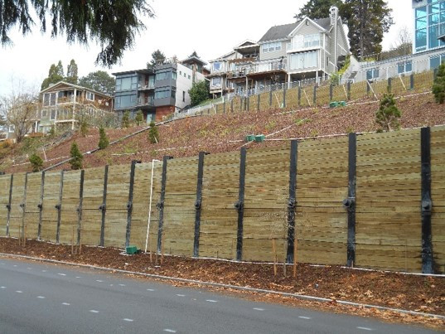
Piling Walls – Soldier Beam

Slide 23
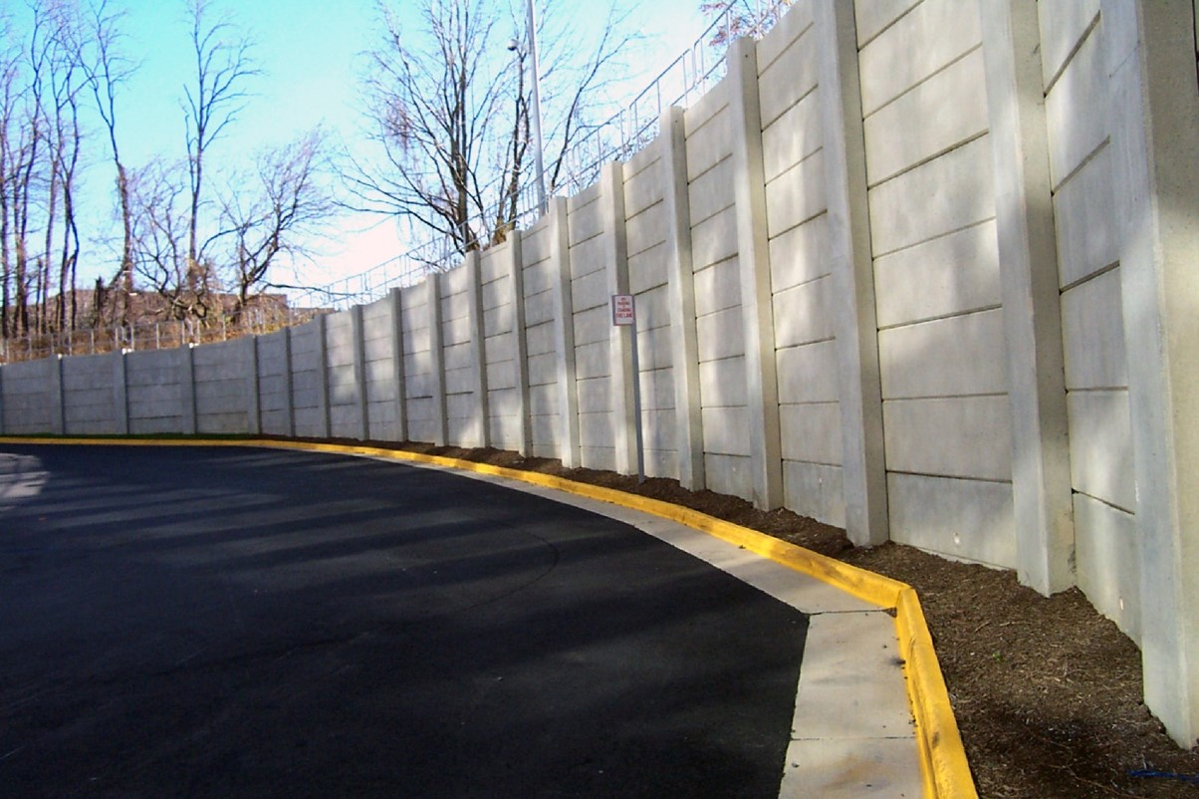
Piling Walls – Pier and Concrete Panel

Slide 24
Anchored Walls
An anchored retaining wall can be constructed in any of the aforementioned styles but also includes additional strength using cables or other stays anchored in the rock or soil behind it.

Slide 25
Anchored Walls

Slide 26
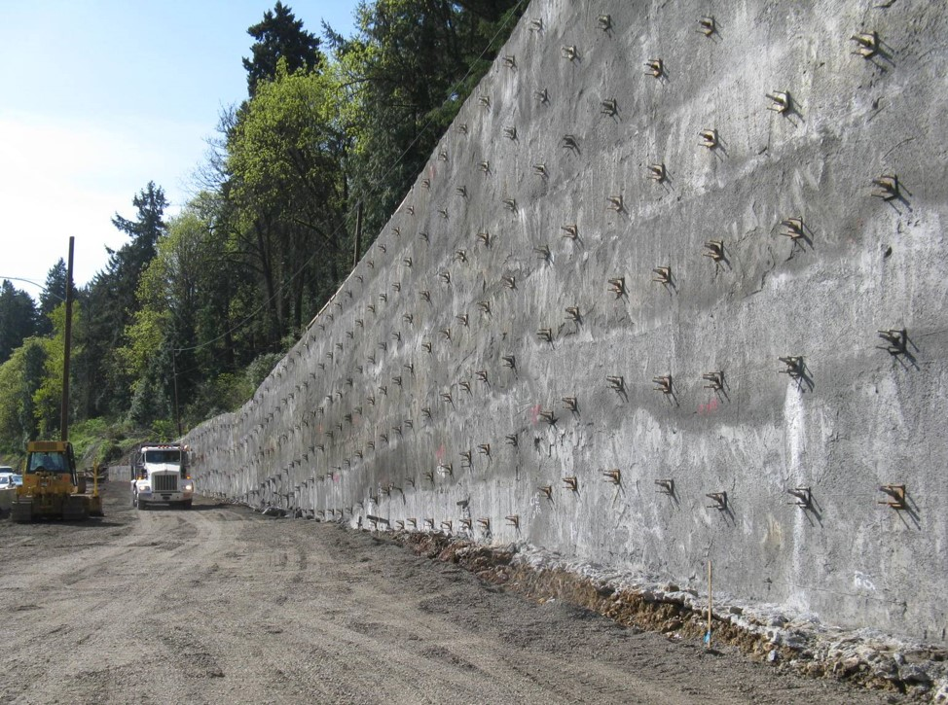
Anchored Walls – Soil Nail Wall

Slide 27
Anchored Walls

Slide 28
Anchored Walls – MSE

Slide 29
Anchored Walls – Massive MSE

Slide 30
Retaining Wall Uses
Retaining walls are stabilizing structures that are used for holding back earth. There are many reasons for building these structures.
Improve Property’s Appearance
Create a Flat Area
Make a Slope Useful
Provide Hanicapped Accessibility
Improve Site Drainage
Hold Back Water
Simplify Maintenance

Slide 31
Retaining Wall Uses
Improve Property’s Appearance
With proper materials selection, retaining walls can become a highly attractive aesthetic feature of your property. They are wonderful devices for creating interest features in a landscape. You have probably seen many upscale entryways that utilize retaining walls to create a raised area for signage or to frame the entrance with raised landscaping beds.

Slide 32
Retaining Wall Uses
Create a Flat Area
Flat ground is almost always more useful than a steep slope.
A retaining wall can convert a slope into a flat level area. This can allow for the construction of structures that otherwise couldn't be built on such a property, like a parking lot, sports field, or building.

Slide 33
Retaining Wall Uses
Make a Slope Useful
In many places around the world, whole mountainsides are cut into a series of steps supported by a series of retaining walls. Called terracing, this technique turns land that is too steep to grow crops into useful farm land.
You can utilize this technique on your commercial property, too. Terracing can prevent erosion on steep areas, and can make a steep landscape far easier — and less costly — to maintain.

Slide 34
Retaining Wall Uses
Provide Handicapped Accessibility
Retaining walls are often used to create gently sloped ramps for wheelchair access

Slide 35
Retaining Wall Uses
Improve Site Drainage
Sometimes a retaining wall can be very useful in directing water on a property. They are also often used to address slope issues near bodies of water.
If you are considering building one for this purpose, be aware that there are many local and state regulations that must be followed. It’s a good idea to find out what the permitting requirements are before even starting to work on the design for such a project.

Slide 36
Retaining Wall Uses
Improve Site Drainage
A seawall is a specialized type of retaining wall that separates land from water.
Others function to protect the shore from erosion, to keep the shoreline from shifting, or to create a harbor or docking area for boats. Don’t forget, though — permitting requirements apply here as well!

Slide 37
Retaining Wall Uses
Simplify Maintenance
It is a lot easier to maintain a flat area than to have to prune, mow, or plant a slope. They also provide a natural separation between turf and beds. Over time, these easy-care features can shave significant amounts from the cost of landscape maintenance.

Slide 38
Wall Selection

Slide 39
Wall Selection
Wall type will vary depending on the Client
Highway sector will likely be more stringent about type then Private
Highway sector could also be any Federal / State / Municipality
Typically highway sector follows established codes/Std
(AASHTO LRFD Bridge manual, FHWA, Caltrans, etc.
Required Right of Way (ROW) for construction
Performance Issues
(Settlement, lateral Movement, Water tightness)
Cost, Aesthetics, Environmental
Durability and Maintenance requirements

Slide 40
Designing /Selecting Retaining Walls
Type of material being retained
Surcharge loads
Type of retaining wall that would work best for the scenario
Ground Conditions
Soil Shear Strength
– Short Term, C and phi
– Long Term, C’ and phi’
Ground Water Table
Site Slopes
Necessary Fill
Necessary Cut

Slide 41
Selection - Gravity Walls
This is the most simple retaining wall.
Generally trapezoidal constructed of mass concrete
Relies on self weight to resist overturning and sliding
Typical heights 3 to 10 ft

Slide 42
Selection - Gravity Walls
Advantages
Cheap and Simple to build – particularly suitable for remote areas (such as Mountains) where they can be built from locally available materials
When constructed from natural materials can look attractive
Disadvantages:
Limited to about 5m height (wall becomes too big for higher walls).
Space needed behind wall for construction and backfilling.
Not suitable for soft soils due bearing failure.

Slide 43
Selection - Cantilever Walls
Generally consists of steel reinforced concrete stem and base
Relies on weight of soil above base to resist overturning and sliding
The vertical ‘stem’ of the wall acts like a cantilever structure to support the lateral earth pressure on the back of the wall.
Typical heights of 6 to 30 feet

Slide 44
Selection - Cantilever Walls
Advantages:
Take up small space with much of structure below ground
No specialist equipment required – standard reinforced concrete skills required for construction
Disadvantages:
Prone to sliding failure – often require propping
Space required behind wall for construction and backfilling
Height limited to about 6m.
Not suitable for soft soils due bearing failure

Slide 45
Selection - Piling Walls
Embedded cantilever walls also support lateral earth pressures by acting as cantilever structures. But instead of fixity for the cantilever coming from a rigid base, it comes from the passive lateral earth pressure in front of the wall.
They are quick to install and can be installed in difficult site conditions, such as on soft ground or under water. They are installed in flat ground before excavation in front of the wall. They require special equipment for installation which can make them expensive. However, when prop or anchor supports are provided, there is theoretically no limit to the height of embedded cantilever walls. (Props are external structural supports to a wall and anchors are installed in the soil behind the wall).
The walls can be constructed of driven steel sheet piles, reinforced concrete bored piles or reinforced concrete diaphragm walls.

Slide 46
Selection - Piling Walls
Advantages:
Narrow walls which take up little space.
Can be installed up to the site boundary with little or no space required behind the wall for construction – this is particularly advantageous in built-up areas.
Installed quickly and early in construction and wall can form both temporary and permanent support to excavation.
No restriction on height of wall.
Can be installed in weak ground.
Disadvantages:
Expensive option (for short walls).
Specialized skills and equipment are required for their installation.
Vibrations and noise can be issues for neighboring properties

Slide 47
Selection - Anchored Walls

Slide 48
Selection - Anchored Walls
Advantages:
Very versatile in design options
Install easily
Materials are readily available
Can be used to create high, curved or shaped walls
Interlocking walls possible
DIY applications for Homeowners
Can be built in confined areas
Disadvantages:
Quality control is critical on the anchorage capacity
MSE and SRW require proper reinforcement orientations and locations
Require proper drainage

Slide 49
Retaining Wall Stability
External Stability Check
Sliding
Overturning
Bearing Capacity
Global Stability
Settlement

Slide 50
Stability - Gravity Walls

Slide 51
Stability - Cantilever Walls

Slide 52
Stability - Piling Walls

Slide 53
Stability - Anchored Walls
Internal Stability
Tensile Resistance
Pullout Resistance
Face Element
Face Element Connection
MSEW reinforcement

Slide 54
Typical Factors of Safety
External Stability
Sliding – FS > 1.5
Limiting Eccentricity – e < B/6
Bearing Capacity – FS > 2.0
Global Stability – FS > 1.3
Settlement

Slide 55
Thank You
Thomas M. Vick, P.E., PMP
TTL, Inc.
1045 Central Parkway North, Suite 103
San Antonio, TX 78232
210-888-6100
tvick@ttlusa.com
www.TTLUSA.com

