Slide 1

ROAD TO RETIREMENT
Richard Ashcraft
TCDRS Member Services Field Representative
Texas Association of County Engineers and Road Administrators Conference
October 17, 2018

Slide 2
TCDRS DOES
RETIREMENT RIGHT
One of the best-funded plans in
the country
Features keep us financially strong
  Savings-based benefits
  Responsible plan funding
  Flexibility and local control

Slide 3

HOW YOUR PLAN WORKS

Slide 4

4%, 5,%, 6%, or 7% is deposited into your account and earns 7% annually.
EMPLOYEES SAVE FOR OWN RETIREMENT
4

Slide 5
COMPOUND INTEREST PAYS OFF
Cumulative Interest
Cumulative Employee Deposits
Example only – Projected amounts based on employee deposit of $1,000 in year 1 and annual salary increases using the TCDRS graded valuation salary scale.
5
Notes:
Very important to note that this is just an example. The point is that the longer you work, you will eventually start earning more in interest than what you are depositing thanks to compound interest (or interest on interest).

Slide 6
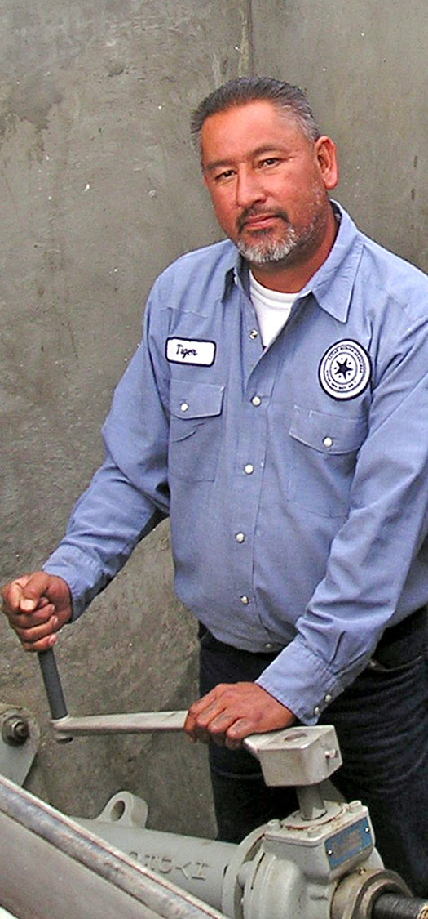
Final account balance matched at retirement. Current matching is 100% - 250%.
EARNING A
LIFETIME
BENEFIT
6
6

Slide 7
Total
Retirement Funds
Fixed
Monthly Benefit
$
AGE
+
ACCOUNT
BALANCE
EMPLOYER
MATCHING
BENEFIT
PAYMENT OPTION
7

Slide 8

YOUR ELIGIBILITY

Slide 9

Service Time
1 MONTH TCDRS DEPOSIT =
1 MONTH SERVICE TIME
Vesting Level
CHOSEN BY EMPLOYER
5, 8, or 10 YEARS OF SERVICE
Vesting + Eligibility
LIFETIME MONTHLY BENEFIT
9

Slide 10
OTHER WAYS TO EARN SERVICE TIME
6 6
=
Multiple
TCDRS
Accounts
Proportionate
Retirement
Program
Military or
USERRA
ERS (State of Texas)
JRS (Courts)
TRS (Schools)
TMRS (Select Cities)
COA (City of Austin)
10

Slide 11
AGE
SERVICE
Age 60 | and | 5,8, or 10 Years
Age | plus | Years of Service*=75 or 80
Any Age | and | 20 or 30 Years
*Must be vested
11

Slide 12

LIFE EVENTS
AND YOUR TCDRS ACCOUNT
  Naming a Beneficiary
12

Slide 13
    One or Multiple Individuals
    Minor Children
    Estate
    Charity or Other Organization
    If no beneficiary on file, TCDRS will pay benefit to spouse (if married) or estate.
13

Slide 14
SURVIVOR BENEFIT
With 4 or more years of TCDRS service, your beneficiary is eligible for the Survivor Benefit:
        One of Two Options
        Lifetime
        Monthly Benefit
        (Employer Matching Included)
        Withdrawal
        of Account Balance
        (No Employer Matching)
Notes:
Optional slide – only see if employer offers.

Slide 15
GROUP TERM LIFE
Employer chooses to participate in optional life insurance benefit
Provides single payment equal to your yearly salary
This benefit is tied to employment
Retirees receive single payment of $5,000
Notes:
Optional slide – only see if employer offers.

Slide 16
LEAVING EMPLOYMENT
Option 1: Keep Money With TCDRS
  Account continues to earn 7% interest
  Lifetime benefit (when vested and eligible to retire)
Option 2: Rollover
  Lose lifetime benefit and employer matching
  Avoid paying tax penalties
Option 3: Withdraw
  Lose lifetime benefit and employer matching
  Significant tax consequences and possible penalty
Notes:
Optional slide – only see if employer offers.

Slide 17

READY TO
RETIRE

Slide 18
BENEFIT PAYMENT OPTIONS
All Options Provide a
Lifetime Monthly Benefit
7 Options to Choose
From at Retirement
Difference in Monthly Amounts Reflects
Possible Payments
to Beneficiary
Consider if Someone will be Dependent on
Your Survivor Benefit

Slide 19
MONTHLY BENEFIT ESTIMATE EXAMPLE
SINGLE LIFE OPTIONS | MEMBER | BENEFICIARY
Single Life | $2,000 for life | $0
10-Year Guaranteed Term | $1,950 for life | $1,950 (thru 10/2030)
15-Year Guaranteed Term | $1,900 for life | $1,900 (thru 10/2035)
DUAL LIFE OPTIONS
50% to Beneficiary | $1,850 for life | $925 for life
75% to Beneficiary | $1,800 for life | $1,350 for life
100% to Beneficiary | $1,750 for life | $1,750 for life
100% to Beneficiary (with Pop-Up Option) | $1,700 for life | $1,700 for life
RETIREMENT DATE: 10/31/2020
19

Slide 20
PARTIAL
LUMP-SUM PAYMENT
Available Only At Retirement
Optional lump-sum payment up to 100% of your deposits and interest
Reduces your monthly benefit payments
Significant tax consequences
  20% federal withholding and a possible 10% early withdrawal penalty

Slide 21
SELECTING A DATE
Retire last day
of any month
Interest is pro-rated
RECEIVING PAYMENT
Direct deposit last business day of following month
Subject to income taxes
TAX
FORM
SPECIFYING WITHHOLDING
Follow IRS tax tables
No taxes withheld
RECEIVING
TAX FORMS
IRS 1099-R from
TCDRS to file taxes
21

Slide 22
SOURCES OF
RETIREMENT INCOME
PERSONAL SAVINGS
SOCIAL SECURITY
PART-TIME WORK
TCDRS
22

Slide 23
TO INCREASE
YOUR BENEFIT
AGE
Example only: This sample employee has 15 years of service time at age 60. Amounts are shown in future dollars and do not account for inflation. Annual salary increases are based on TCDRS graded valuation salary scale.
23

Slide 24
RULES AGAINST
RETURNING TO WORK
No prior agreement to be rehired
One calendar month break in service
Non-compliance results in suspension of benefits plus repayment of TCDRS money
State and federal law requires signatures upon retiring certifying awareness and compliance

Slide 25




TCDRS.org
800-823-7782
(M-F 7:30 a.m.- 6 p.m.)
memberservices@tcdrs.org
P.O. Box 2034
Austin, Texas 78768-2034
facebook.com/tcdrs
twitter.com/tcdrs
youtube.com/tcdrschannel
25

Slide 26
ROAD TO RETIREMENT
Questions?

