Slide 1
Asphalt Pavement Mix Types
A Descriptive Look at Today’s Asphalt
Pavement Mix Types Used in Texas
Notes:
Six go to mixes in TxDOT’s tool box. This guide will help facilitate when and where to use these different mixes. All mixes used today have the same components – Aggregates – Asphalt Cement – Air – The take away from this presentation – WHERE TO USE ASPAHLT MIX TYPES

Slide 2
Performance Graded (PG) Binders--PG binders are normally used for production of hot-mix asphalt (HMA).
Embedded in the PG binder nomenclature are the temperature extremes under which the HMA pavement must perform (to resist rutting, fatigue, and thermal cracking).

Slide 3
Asphalt Binder Nomenclature (AASHTO M 320)
PG 64 - 22
Typically, the lower (more negative) this number, the softer and more crack resistant the binder
Typically, the higher this number, the stiffer and more rut resistant the binder.

Slide 4
Asphalt Binder Nomenclature
PG 64 - 22
Numbers specified in 6° increments
Meets all requirements down to this temperature (°C)
Performance Grade
Meets all requirements up to this temperature (°C)
Binders are typically selected based on the climate in which they will serve, but the grade can be changed for various other reasons.

Slide 5
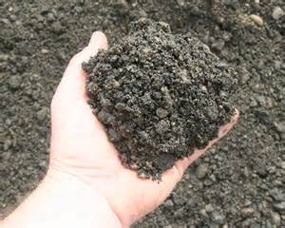
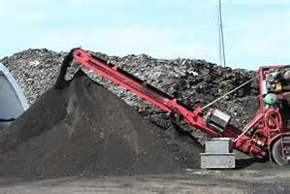
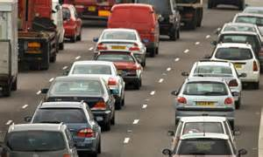
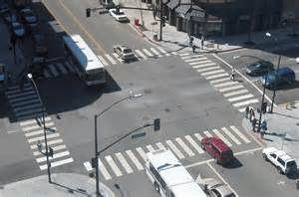
Why different grades might be specified
Softer grades might be specified to balance out the stiffer binder present in Reclaimed Asphalt Pavement (RAP) or Recycled Asphalt Shingles (RAS)
Stiffer grades might be specified to provide more rut resistance under heavy traffic or slow-moving traffic.

Slide 6
Aggregate Tests
Consensus Properties
Pavement experts agreed certain aggregate characteristics were critical for HMA to perform well
Coarse Aggregate Angularity
Fine Aggregate Angularity
Sand Equivalent
Flat and Elongated Particles
Recommend to perform on blend

Slide 7
Aggregate Tests
Source Properties
Source property values are source specific and not reached by consensus. Each agency values these differently based upon pavement needs.
Toughness (LA Abrasion / Micro-Deval)
Soundness (Sodium or Magnesium Sulfate)
Deleterious Materials

Slide 8
TxDOT Bituminous Rated Source Quality Catalog (BRSQC)
Gives information about aggregates used in Texas, and results for Aggregate Quality Monitoring Program (AQMP) testing
L.A. Abrasion (Tex-410-A)
Sulfate Soundness (Tex-411-A)
Polish Test (Tex-438-A)
Acid Insoluble Residue (Tex-612-J)

Slide 9
TxDOT Bituminous Rated Source Quality Catalog (BRSQC)
Surface Aggregate Classification (SAC)
Class A aggregate must comprise at least 50% by weight retained on the No. 4 sieve for aggregate used on the surface of travel lanes
Sandstone (All currently meet Class A)
Limestone-Dolomites (One meets Class A)
Gravels (77% meet Class A)
Igneous Rocks (All meet Class A)
Lightweight Aggregate (All meet Class A)

Slide 10
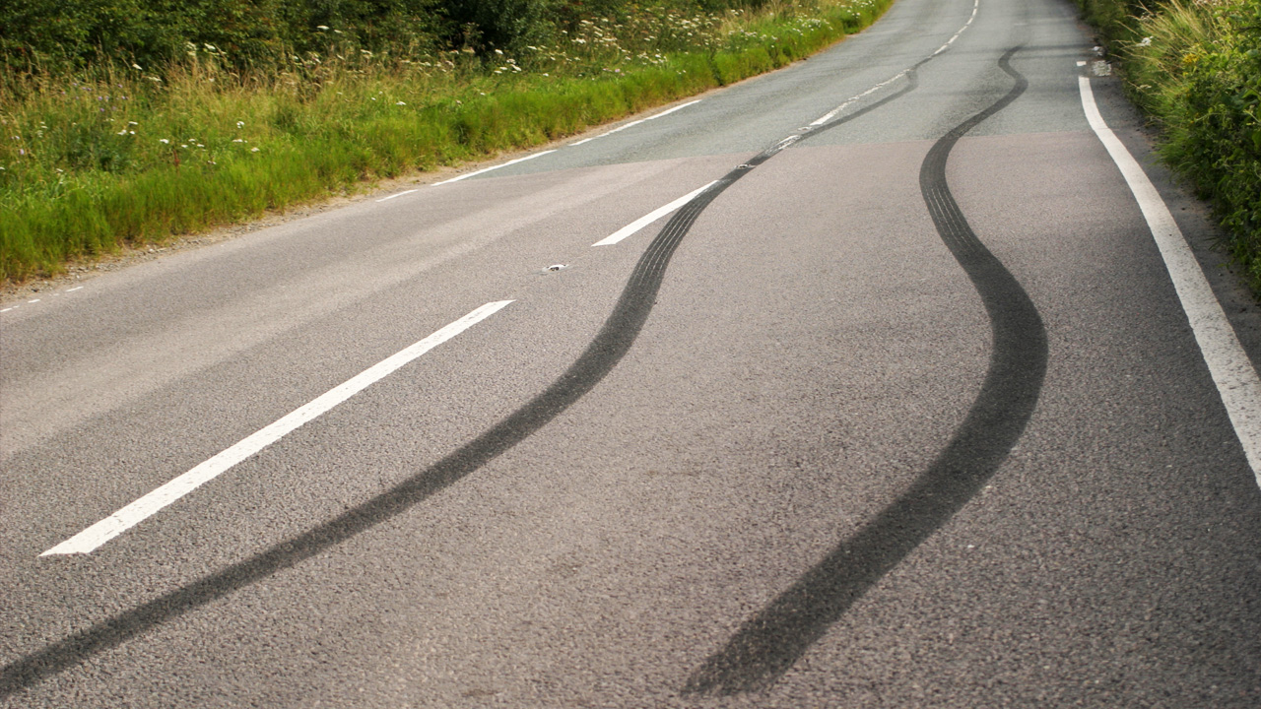
TxDOT Bituminous Rated Source Quality Catalog (BRSQC)
Why Surface Aggregate Classification?
Safety - To guarantee skid resistance by using aggregates which are resistant to polishing, acid rain

Slide 11
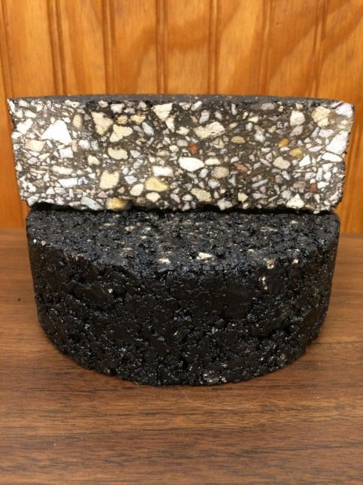
Dense Graded Mixtures
Specification: Item 340, 341
Typical Application: Dense graded mixtures in the QC/QA specification can be used for a wide variety of applications ranging from new construction to overlays. Dense graded mixtures may be appropriate for applications ranging from high volume (or high demand) roadways to low volume (or low demand) roadways depending on the specified binder grade, aggregate properties, etc. Dense graded mixtures can be used as base, intermediate or surface layers.
Additional Information: Dense graded mixtures have been used in Texas for over 50 years. They are usually designed with a Texas gyratory compactor which creates dry mixes. The vast majority of the QC/QA measures are the responsibility of the contractor.
Notes:
Dense graded mixes are the “GO TO” mixes when it comes to design. Utilize these mixes when in doubt. Dense Graded mixes can utilize higher quantities of recycle products and still preform well. As cost continue to rise, utilize higher percentages of recycle products in Detours, Driveways, Cross overs, Mail box Turn outs, and Shoulders can

Slide 12
Dense Graded Mixtures
Advantages
Initial Lower Cost
Contractors & Producers are very familiar with dense grades mixes
Can successfully use higher percentages of recycle material and still perform well

Slide 13
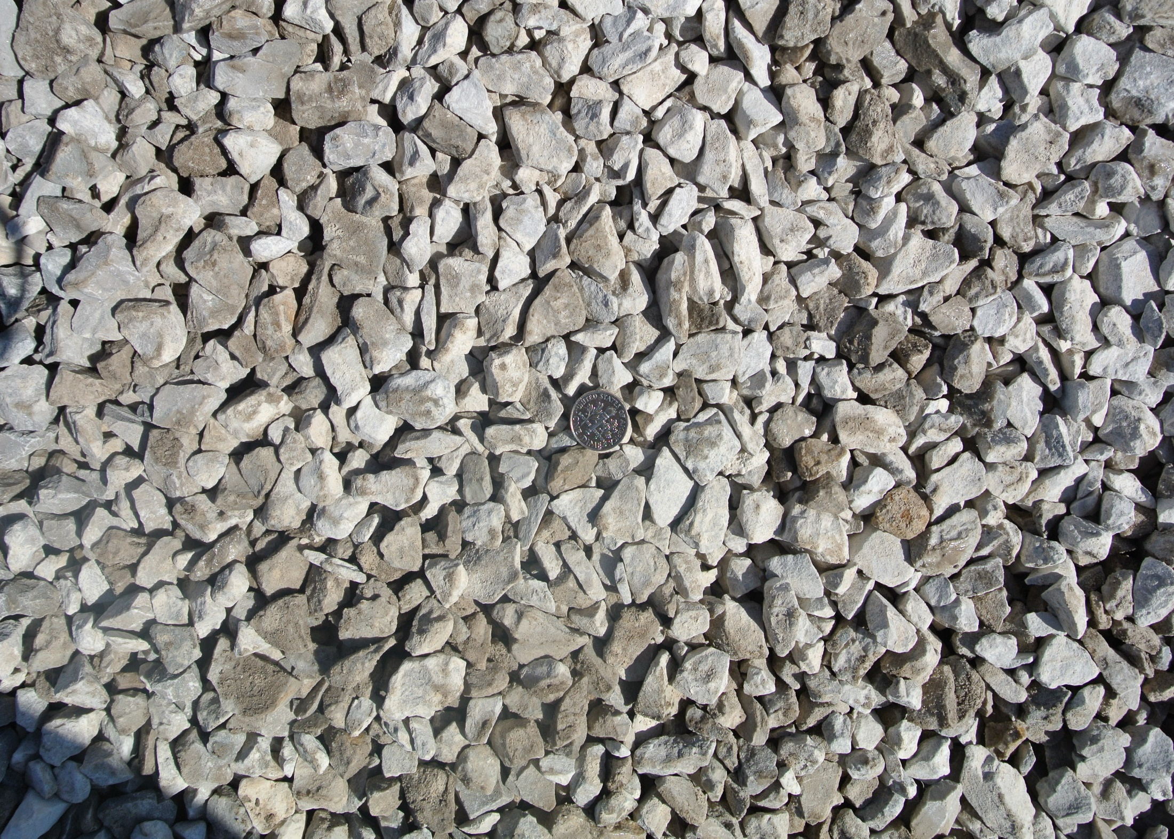
Notes:
Typical Aggregate size for Dense Graded Type D surface mix.

Slide 14
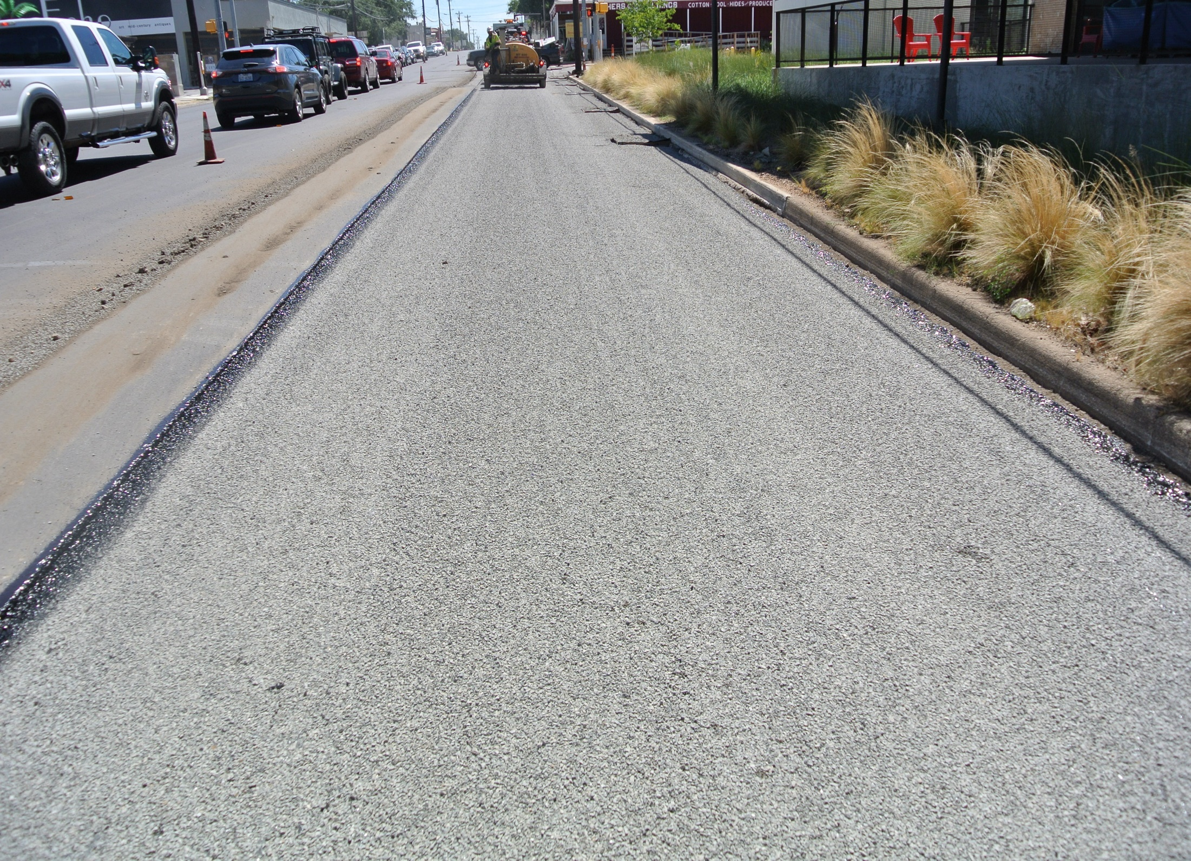
Notes:
Dense Graded mixes work well with traditional mill – seal – overlay operations. Utilize modified binders as warranted with traffic count, speed of traffic, intersection (stop & start).

Slide 15
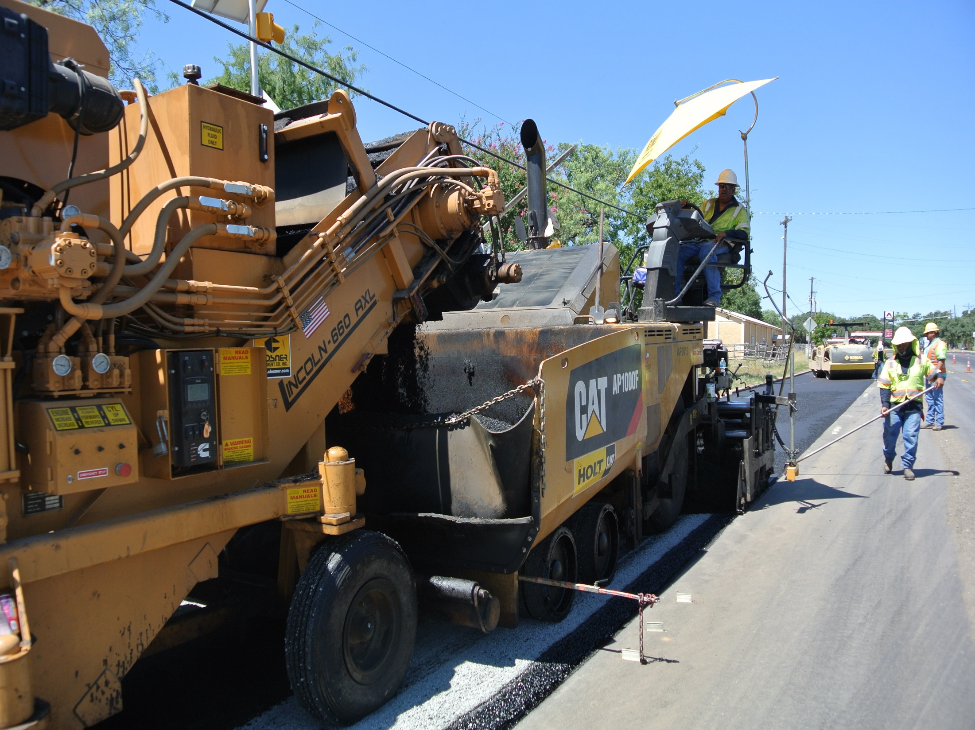
Notes:
Utilize standard paving operations for Dense Graded Mixes – Utilize Ko-kal or Shuttle Buggy as method of delivering mix into the paver. Also utilize standard compaction operations (Break Down Roller – Pneumatic Roller – Finish or polishing Roller.

Slide 16
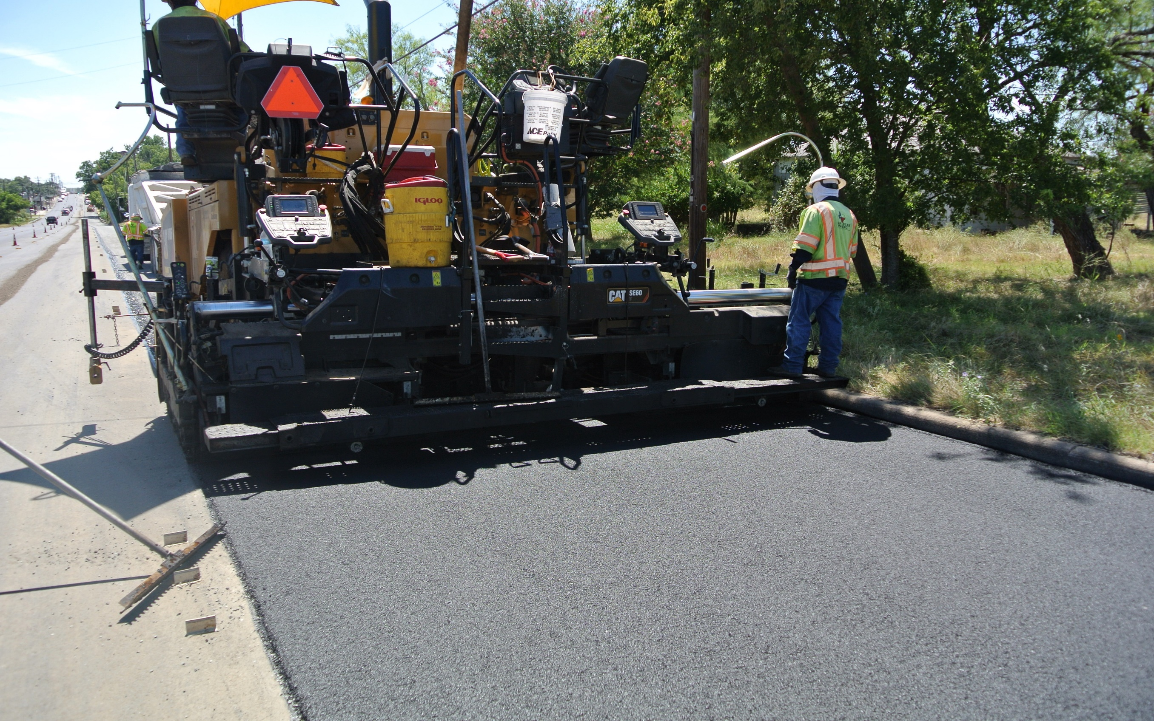

Slide 17
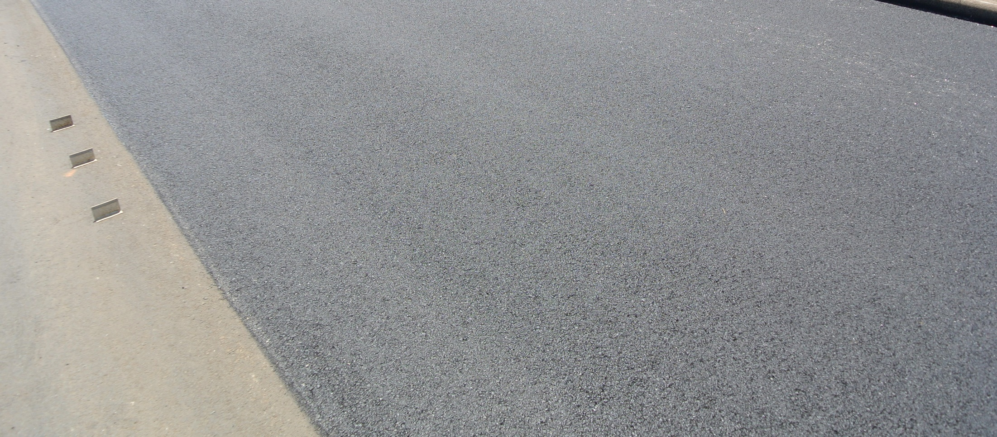
Notes:
Super Pave Mat – Higher AC content to help with fatigue cracking. More structured for a stone on stone contact. Material does cost more then dense graded mixes due to the higher asphalt content. Can be used for all applications.

Slide 18
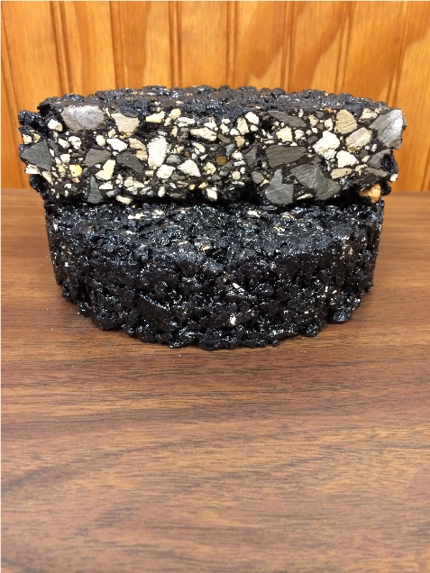
Permeable Friction Course (PFC)
Specification: Item 342
Typical Application: PFC mixtures are used as the surface course on high-speed roadways to optimize the safety and comfort characteristics of the roadway. For this guide, a high-speed roadway is defined as one having a posted speed limit of 45 mph or higher. The standard PFC mixture contains PG 76-22 and fibers and is recommended for the vast majority applications where PFC is used. A-R PFC is often preferred over the standard PFC when placed as an overlay on an existing concrete pavement, when a high degree of noise reduction is desired and when placed as an overlay on a pavement that has a high amount of cracking.
Additional Information: A-R PFC is generally more expensive than the standard PFC; however, its unique properties warrant its use in certain applications.

Slide 21
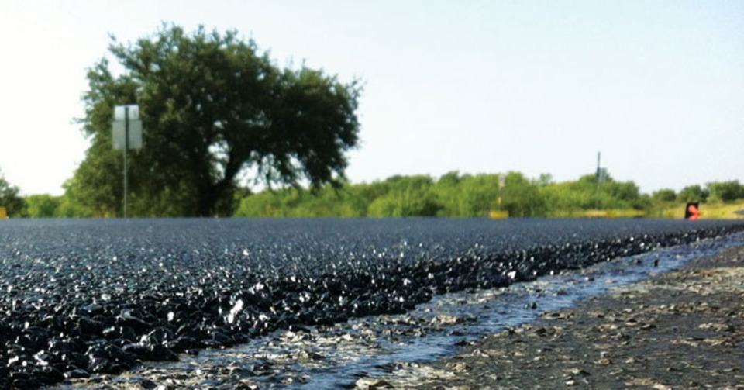

Slide 22
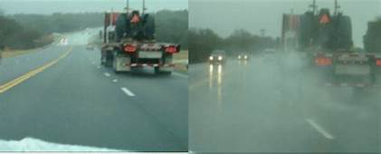

Slide 24
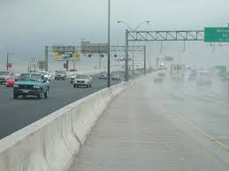
Successful Permeable Friction Course (PFC)

Slide 26
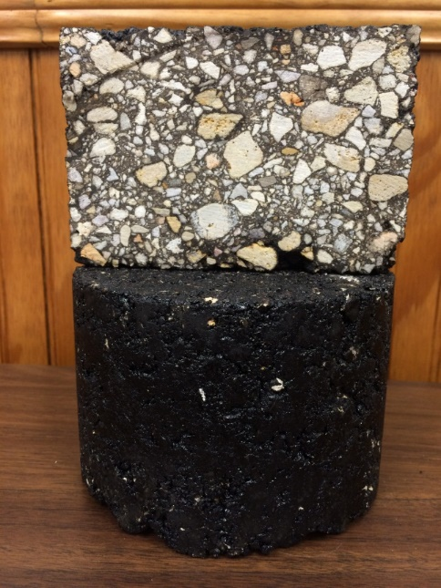
Superpave Mixtures
Specifications: Item 344
Typical Application: Superpave mixtures are usually used on medium to high volume roadways, performance design mixtures may be appropriate for applications ranging from high volume (or high demand) roadways to low volume (or low demand) roadways. Superpave mixtures can be used as base, intermediate or surface layers. Superpave mixtures can be used for a wide variety of applications ranging from new construction to overlays
.
Additional Information: Superpave Mixtures set the bar higher for the contractors to meet in-place density. By using a superpave gyratory compactor it allows for more oil which will help lead to longer lasting asphalt pavements.
Notes:
Mix Design Objective – Stability – Durability – Fatigue Resistant - Flexibility

Slide 27
Super Pave Mixtures
Advantages
Higher asphalt content which helps mitigate cracking & provides greater durability
Stone on Stone contact – Highly resistant to rutting
High skid values – beneficial in terms of wet weather traction

Slide 29
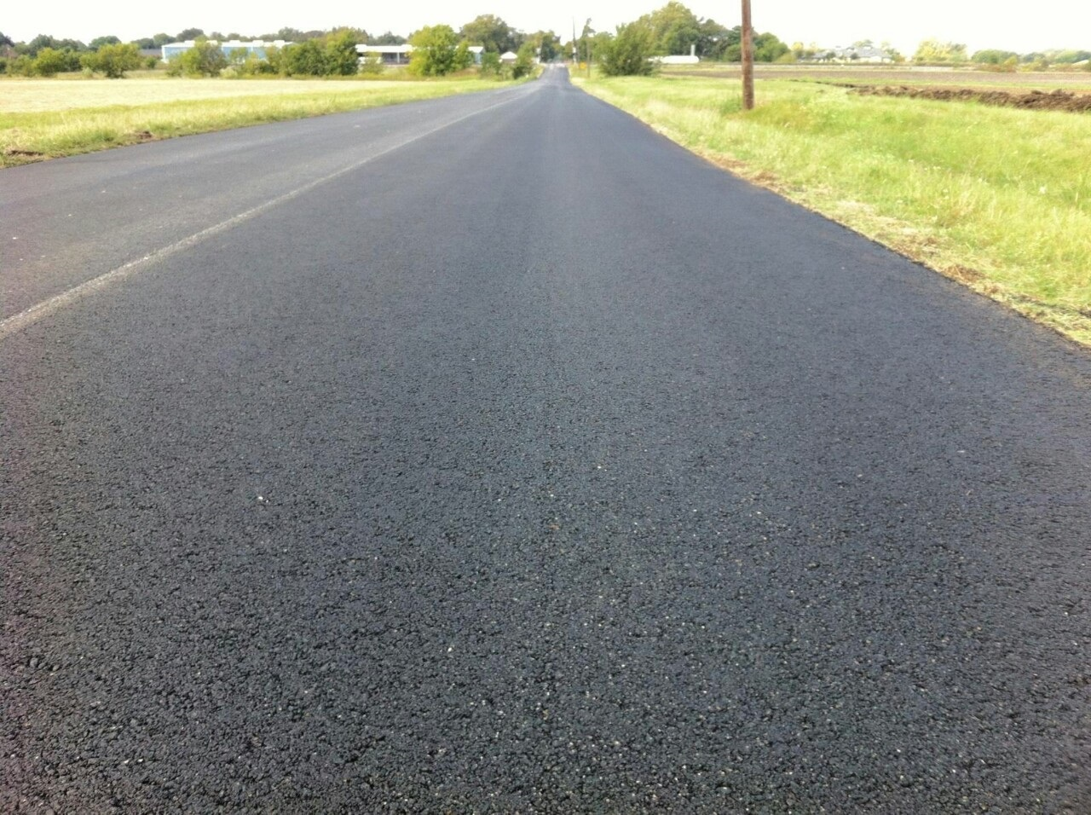

Slide 30
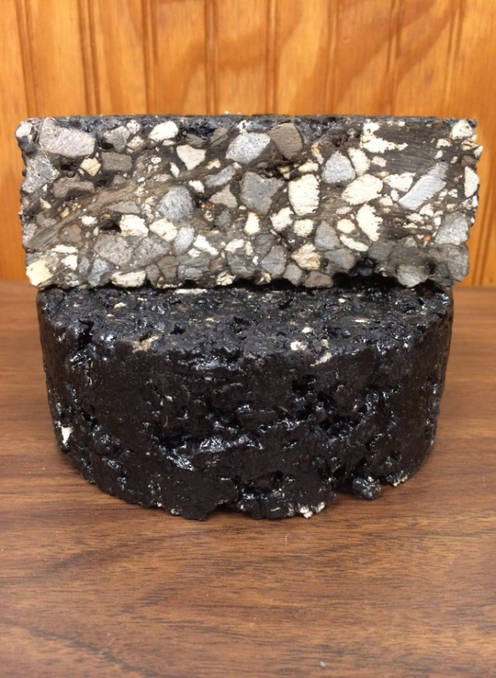
Stone Matrix Asphalt (SMA)
Specification: Item 346
Typical Application: SMA mixtures are typically used as a surface mix or intermediate layer in the pavement structure on high volume (or high demand) roadways. The standard SMA mixture contains PG 76-22 and fibers, and is recommended for the vast majority applications where SMA is used.
Additional Information: SMA mixes are usually an intermediate layer with PFC placed as the surface layer, although they work excellent as surface courses. SMA contains higher oil contents and require higher quality aggregates which tend to increase the costs when compared to dense graded mixes

Slide 31
Stone Matrix Asphalt (SMA)
Advantages
Provide both excellent rut resistance & crack resistant
Stone on Stone contact providing for more durable surface course
Cadillac of mixes – proven to provide 20% to 30% increase in pavement life over conventional mixes

Slide 32
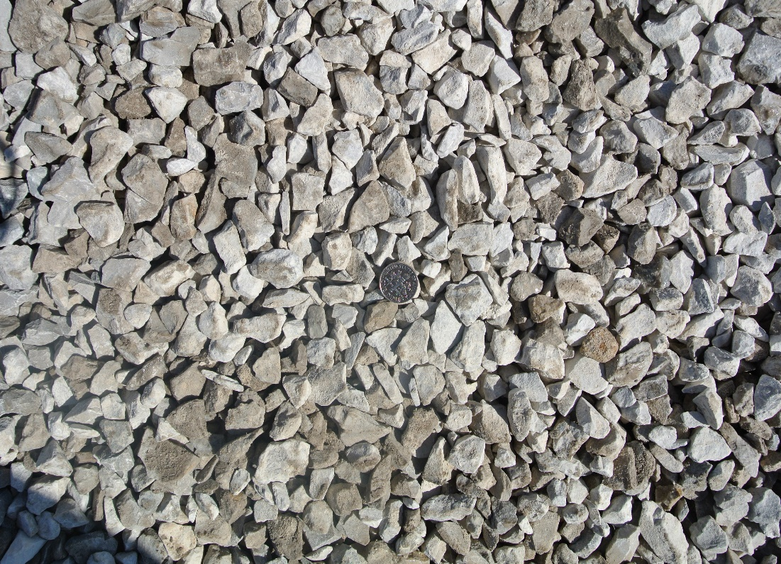
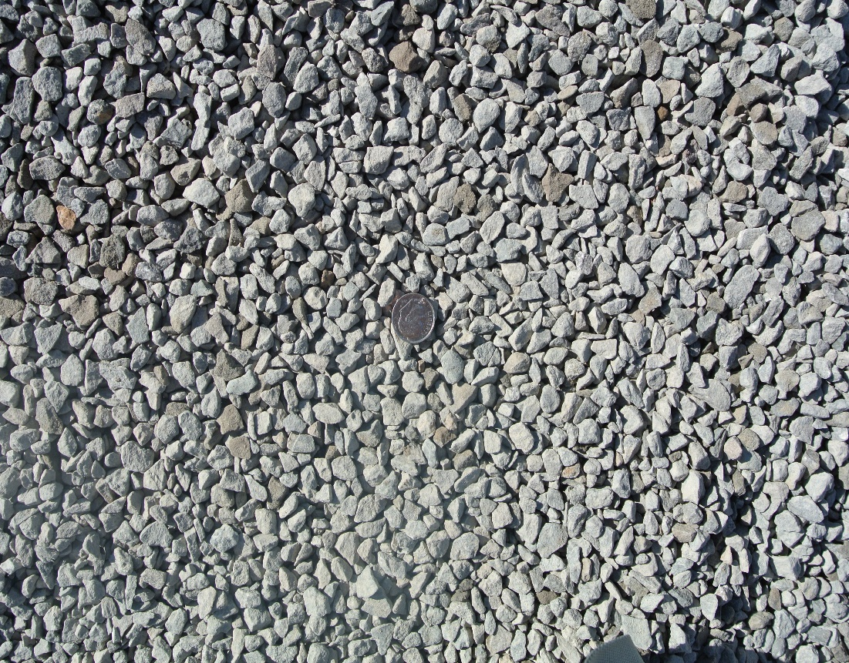
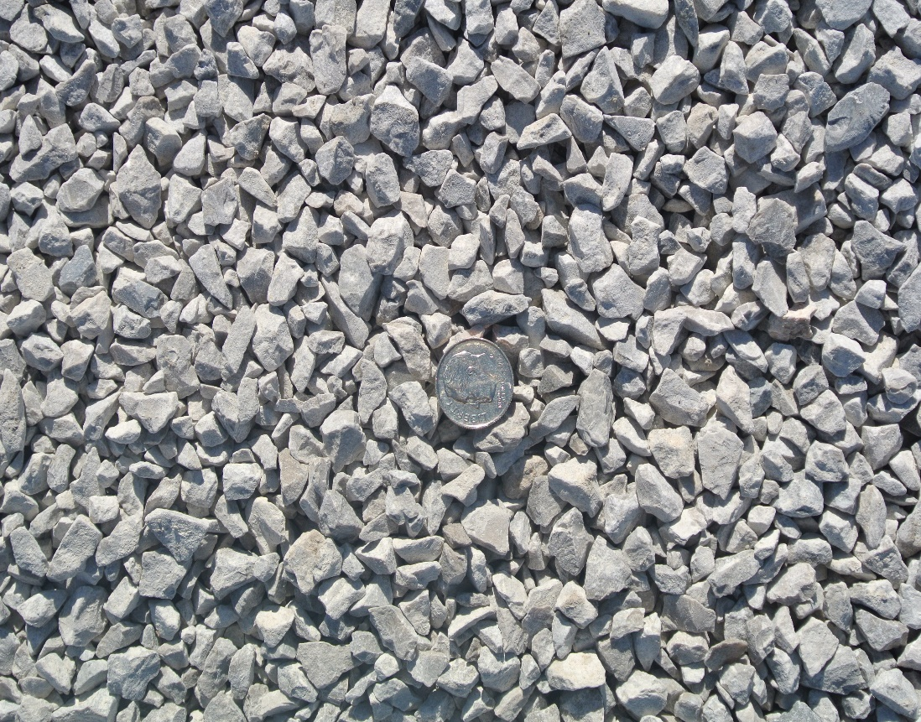
Notes:
SMA Aggregate Interlock to provide low permeablilty

Slide 34
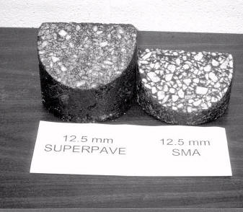
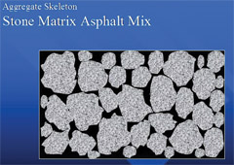

Slide 35
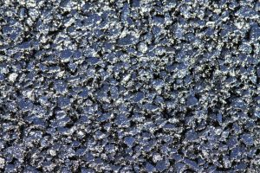
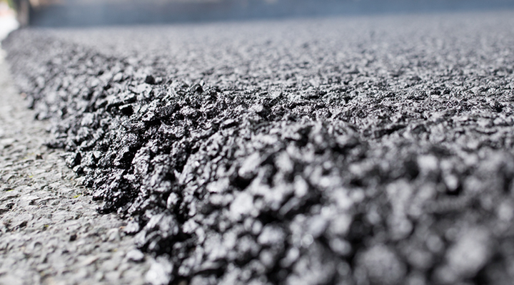

Slide 36
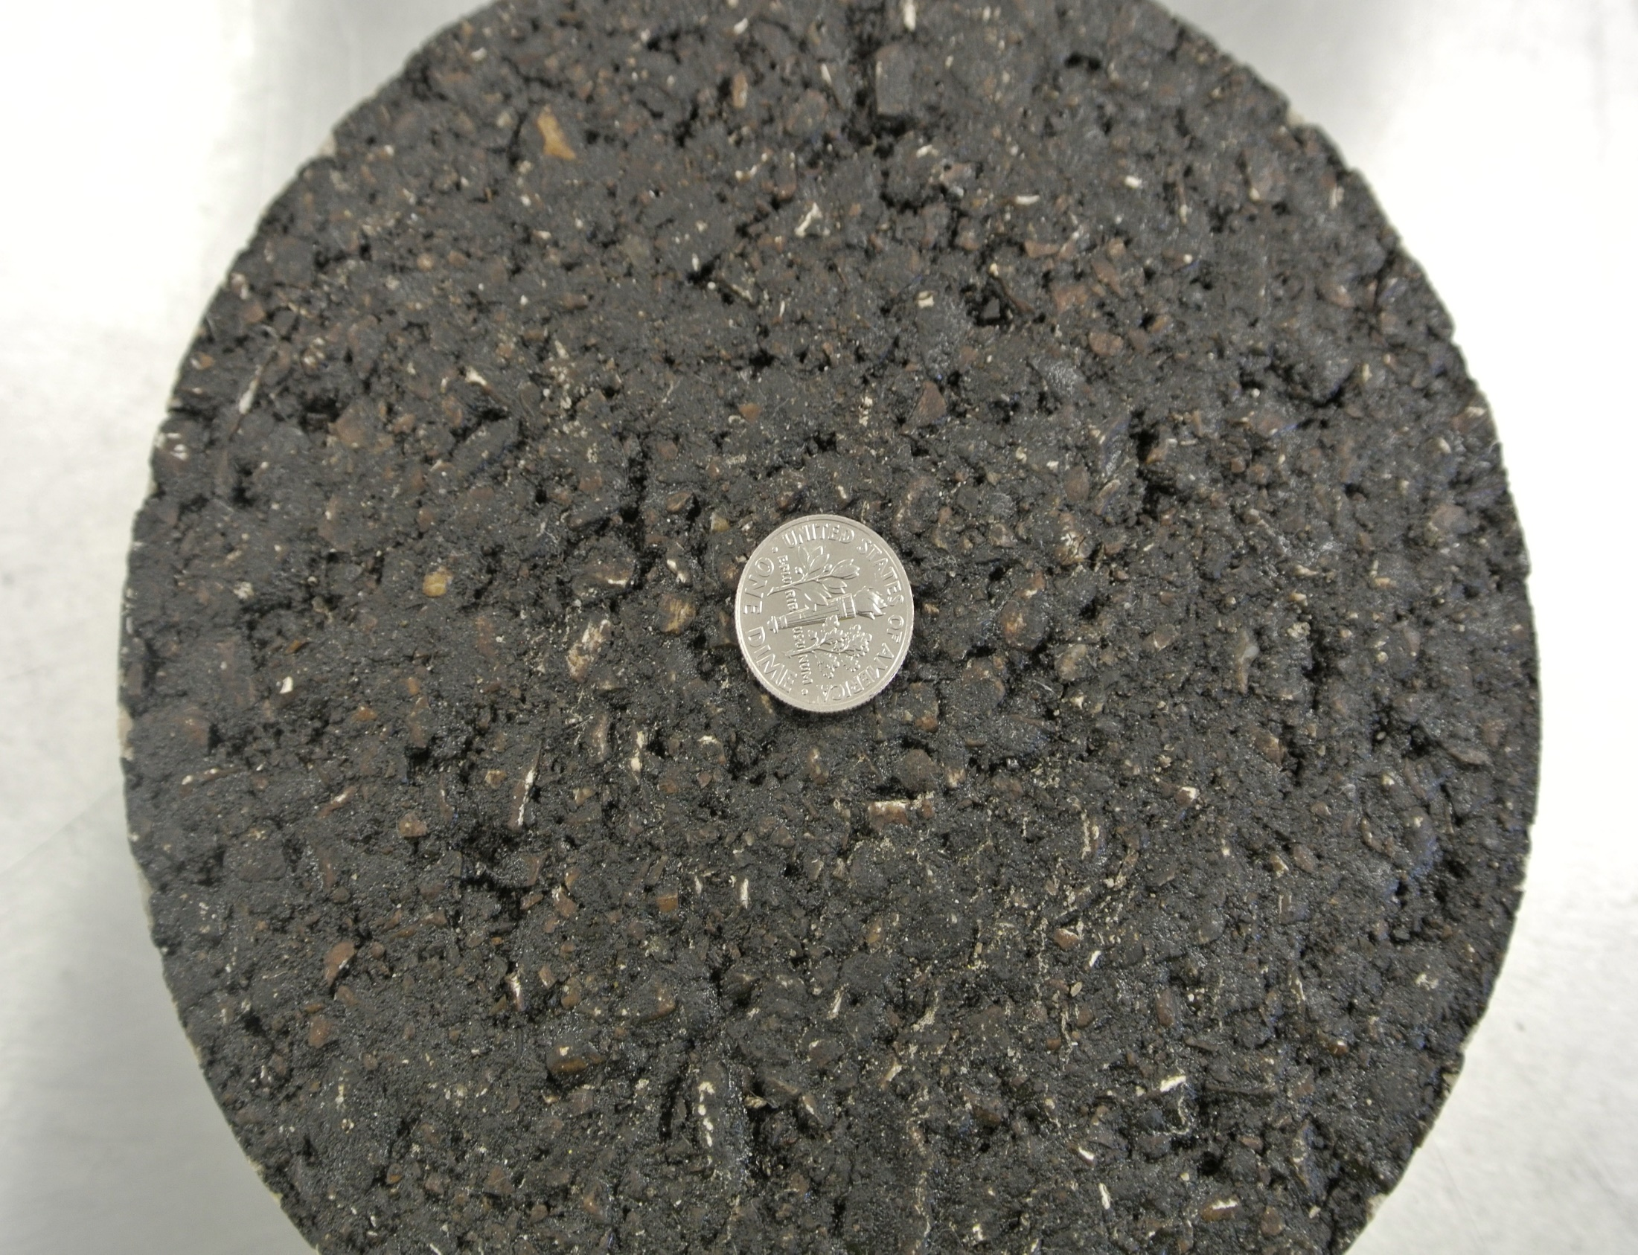
Notes:
TOM Core

Slide 37
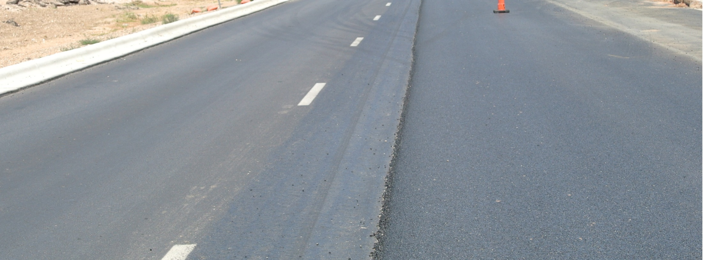
Successful Stone Matrix Asphalt (SMA)

Slide 38
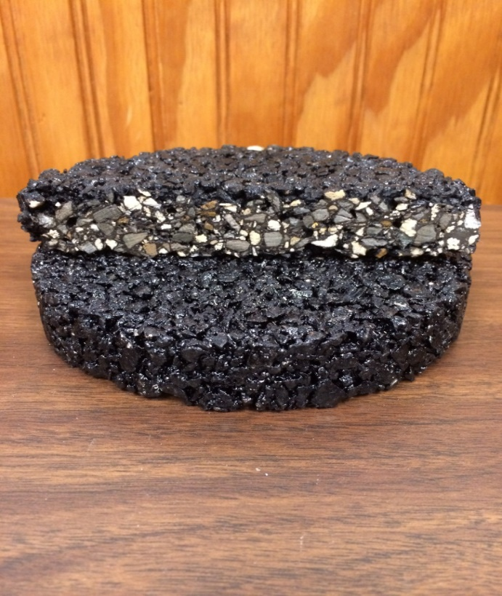
Thin Overlay Mix (TOM)
Specification: Item 347
Typical Application: TOM mix is a high-performance overlay mix placed at thickness between 1.0” to 1 ¼”. They are primarily used for preservation of existing pavements, high and low volume roadways, and roadways where a crack-resistant mix is needed.
Additional Information: TOM mixes have higher asphalt contents which can go up to 7.0% depending on aggregate combinations. They require higher quality aggregates than conventional mixes. TOM mix typically uses a 70-22 or 76-22 oil. TOM mix must meet a minimum 300 cycles on the overlay tester and applicable Hamburg test.

Slide 39
Thin Overlay Mix
Advantages
Durable – Flexible and resistant to rutting and or cracking
Stone on Stone contact for coarse surface texture
High skid values – beneficial in terms of wet weather traction
Reduces noise decibels for quite ride
Improve ride quality

Slide 40
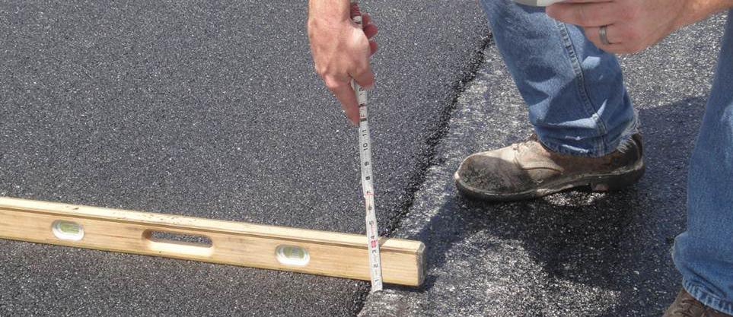
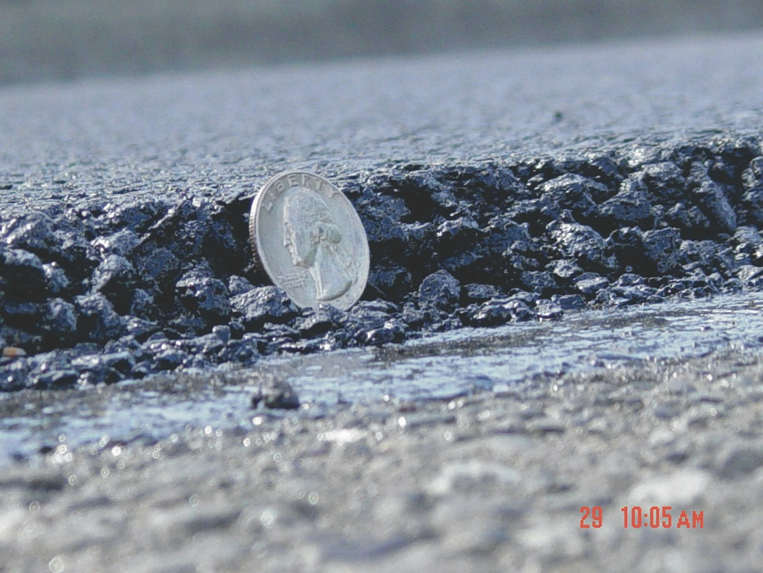
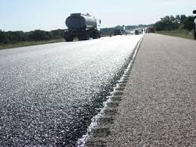

Slide 41
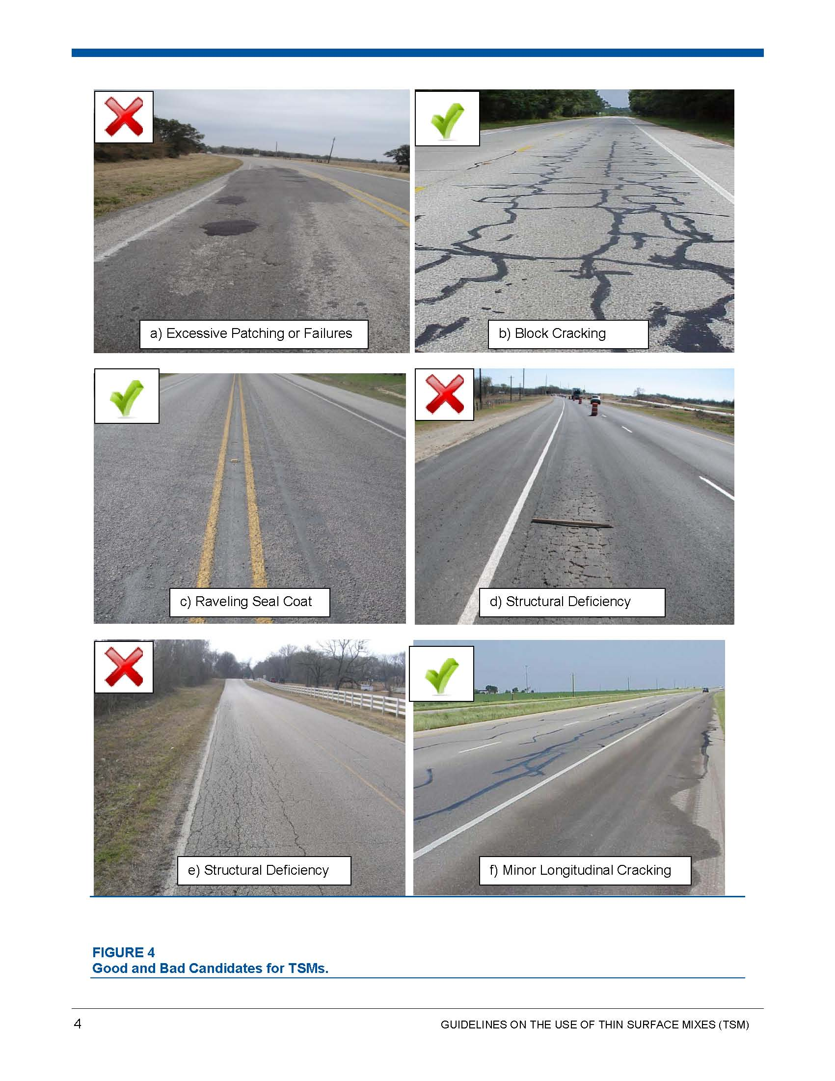

Slide 43
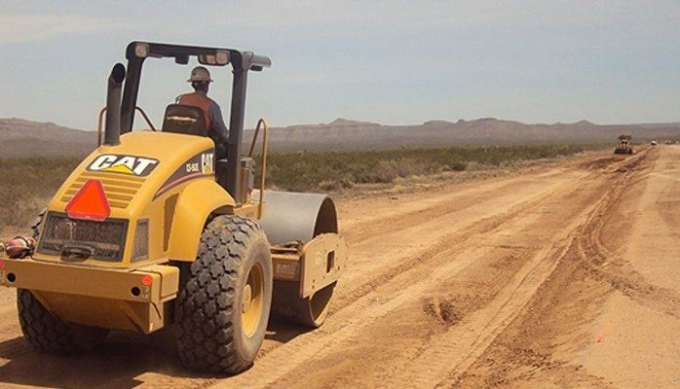
NEVER USE A THIN OVERLAY MIX DIRECTLY ON FLEX BASE

Slide 44
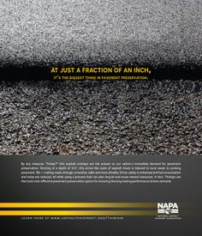
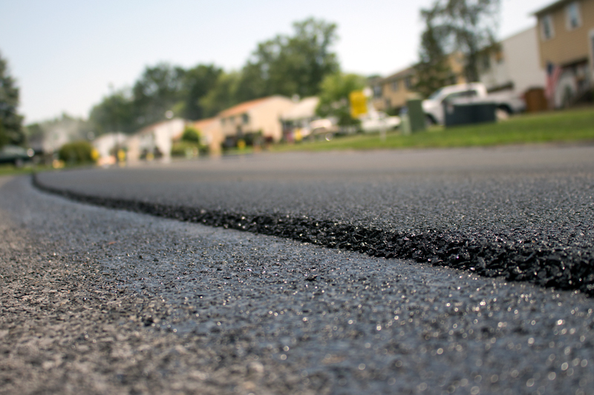
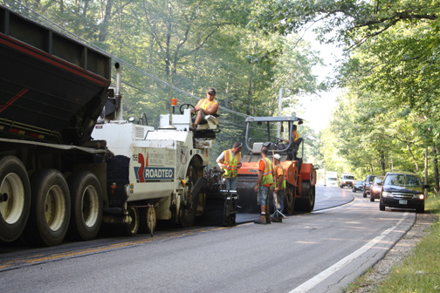

Slide 45
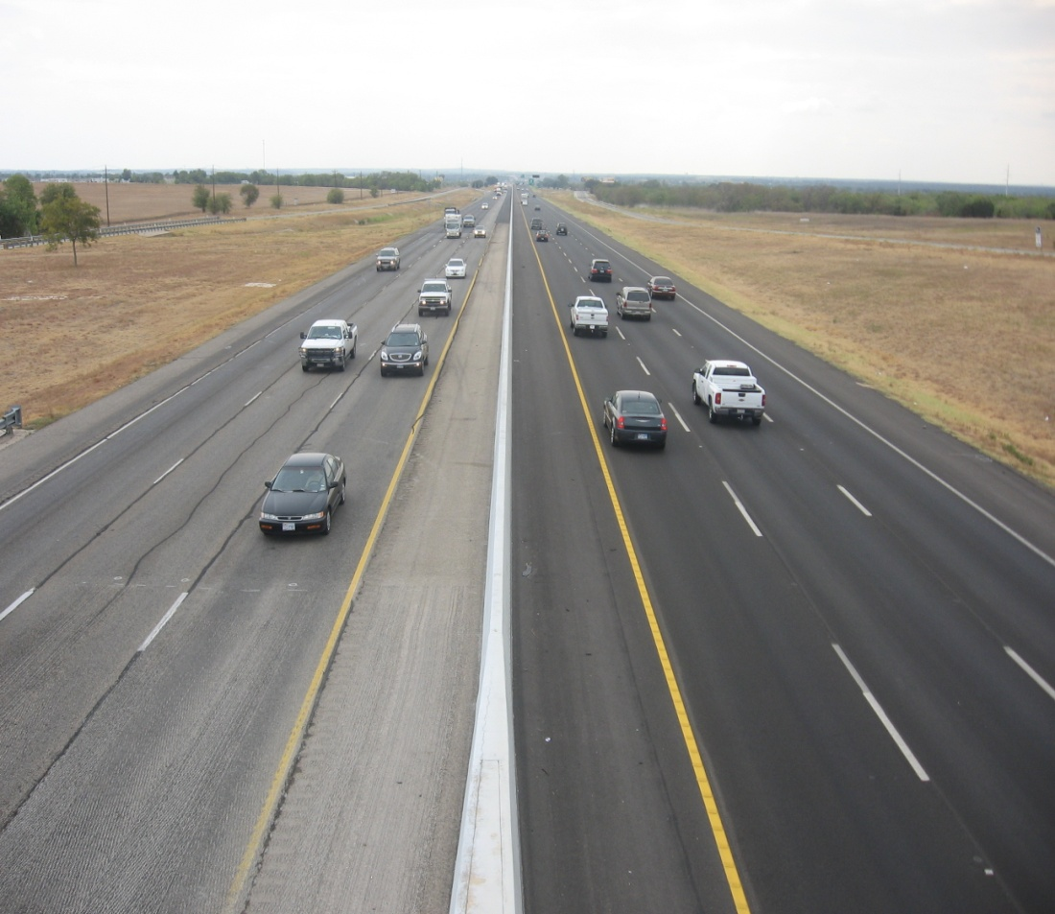

Slide 46
Thin overlay mixtures (tom)

Slide 47
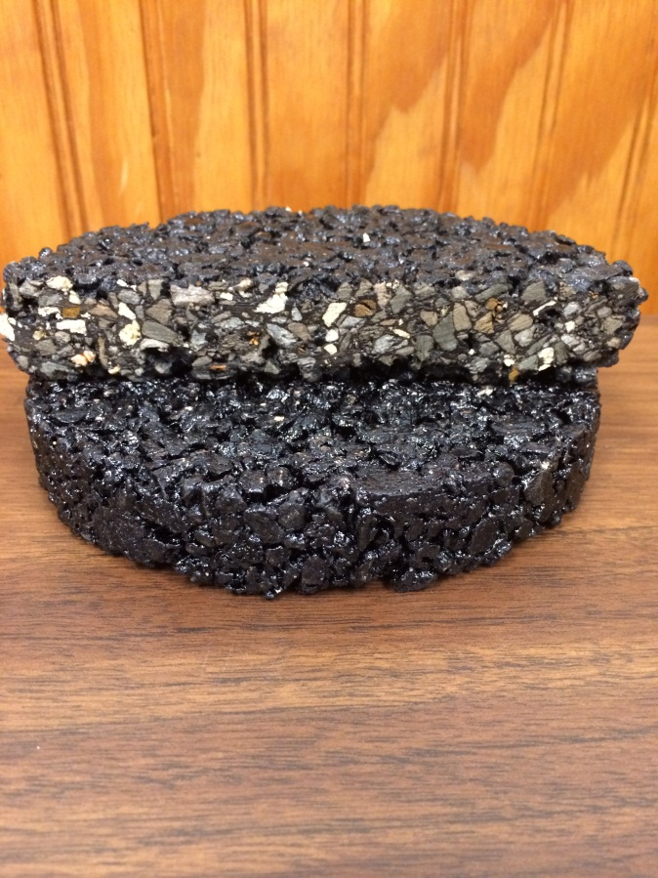
Thin Bonded Friction Course
Specification: Item 348
Typical Application: : TBFC mixtures are used as a surface course on high-speed roadways to optimize the safety and comfort characteristics of the roadway. TBPFC mixtures may be placed in thin lifts starting at ¾-inch. TBFC includes an application of a polymer modified emulsion membrane prior to the placement of the PFC mixture. The materials and mixture requirements for the TBFC placed on the membrane are the same as those specified in Item 342. TBFC is recommended in lieu of PFC from Item 342 when placed as an overlay on an existing concrete pavement or when placed as an overlay on a pavement that has a high amount of cracking
Additional Information: TBFC have a higher initial cost compared to other mixes. The process calls for specialized equipment that may not be available at all times during construction. Asphalt content ranges from 6% to 8% compared to other mixes.
Notes:
Pavement prep is most important when selecting Thin Bonded Friction Course –Placement Testing includes Tex 246 Permeability – Tex 244 Thermal Profiling

Slide 48
Thin Bonded Friction Course
Advantages
Use Item 348 in lieu of item 342 PFC when placed as overlay on existing concrete
High speed surface course – optimize safety through wet weather traction
Noise reduction in urban areas & restores smooth ride on existing pavement

Slide 49
Thin Bonded Friction Course
Two Different Mix Types
Permeable Friction Course – Fine PFC and Coarse PFC – Same Gradation requirement as item 342 (PFC) (18 – 22% air voids using 6-7% asphalt binder) – must use spray paver –
Thin Bonded Wearing Course – It is also permeable, but not as much (8% air voids) – uses less asphalt binder (5-5.8%) – no fiber & no lime

Slide 51
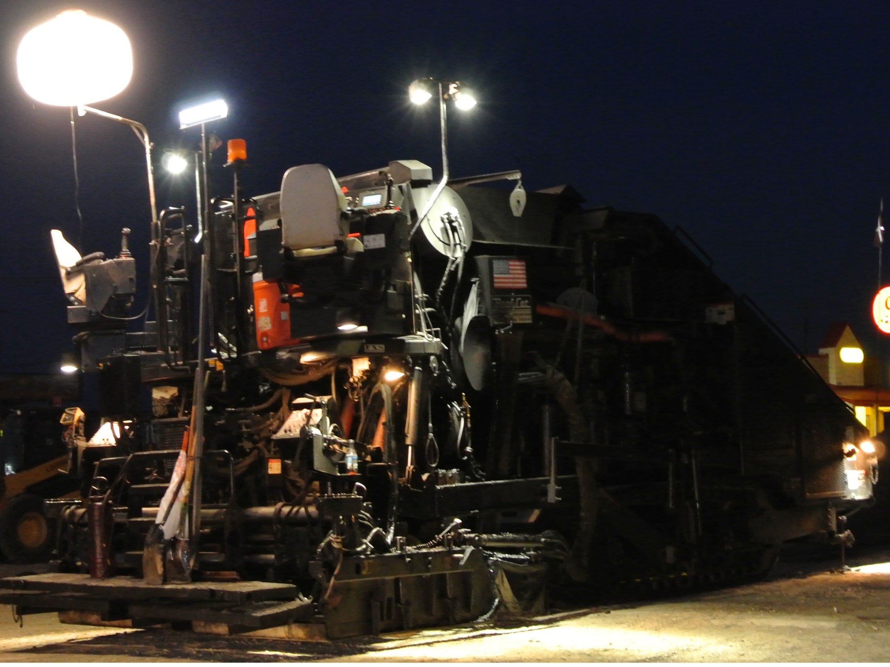
Notes:
Specification notes state that the paver must be equipped to apply membrane and mix in a single pass with no more than 5 second lag between the two – Also calls for static rolling only – no vibrating – no pneumatic.

Slide 53
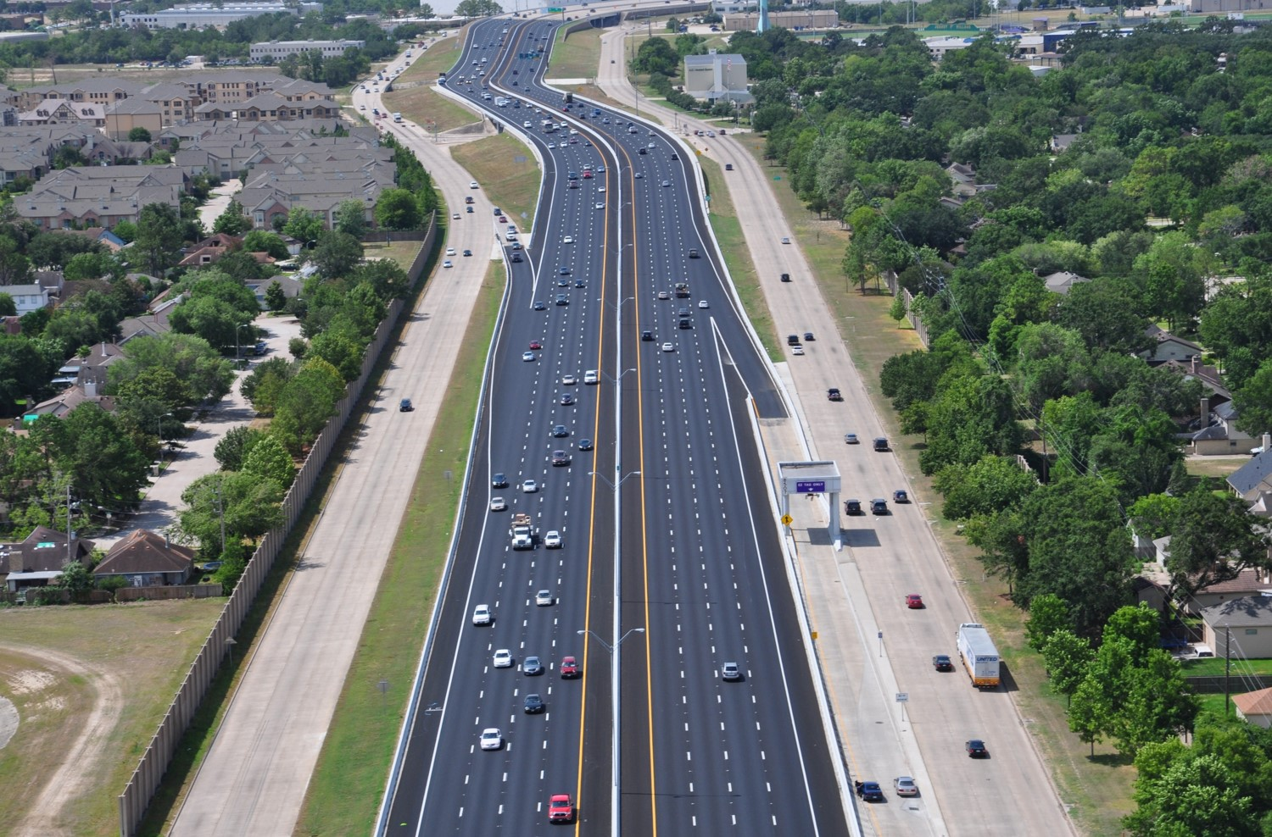

Slide 54
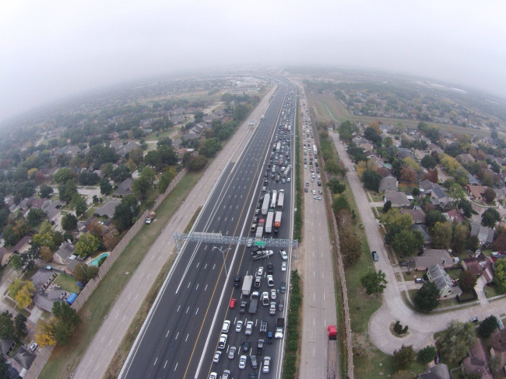

Slide 55
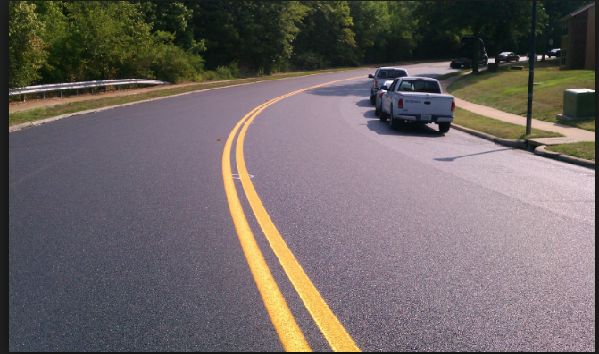
Successful Thin Bonded Friction Course Project

Slide 56
Types Of Mixes-Asphalt Content %
Dense Graded
Superpave
SMA
PFC
TOM

Slide 57
ASPHALT RESOURCES
Asphalt Alliance – asphaltroads.com
TXAPA – www.texasasphalt.org
HMAC – www.txhmac.org
NAPA – www.asphaltpavement.org
Warm Mix Asphalt –
www.warmmixasphalt.com
www.DriveAsphalt.com
www.beyondroads.com

Slide 58
Dedicated to Quality
How we approach the issues !
Partners In Quality
Commitment Communication
Cooperation

Slide 59
KNOW YOUR ASPHALT!

