Slide 1
Centrifugally Cast Concrete Pipe - CCCP
Materials and Technologies For The Rehabilitation of Stormdrain Pipe and Culverts

Slide 3
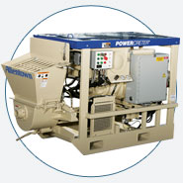
PERMACAST® PL-12,000
PERMACAST® PL-8,000

Slide 4
Minnesota DOT
“Our district is faced with thousands of deteriorated centerline roadway pipes,” says Ruth Betcher, P.E., hydraulics engineer for the Minnesota Department of Transportation’s (MNDOT) District 6, “and replacing all that pipe is cost prohibitive—and also, citizens don’t welcome detours!”

Slide 5
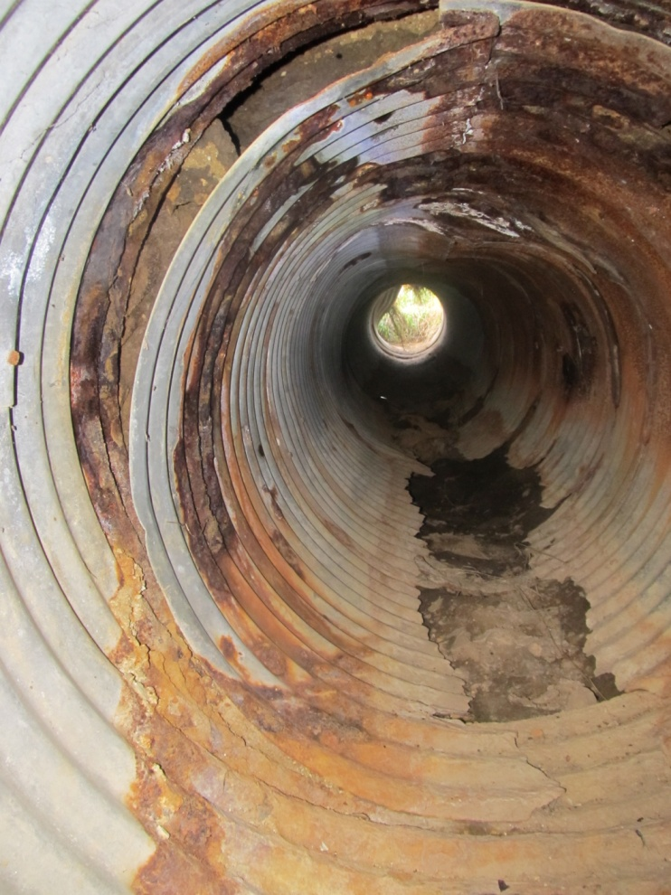
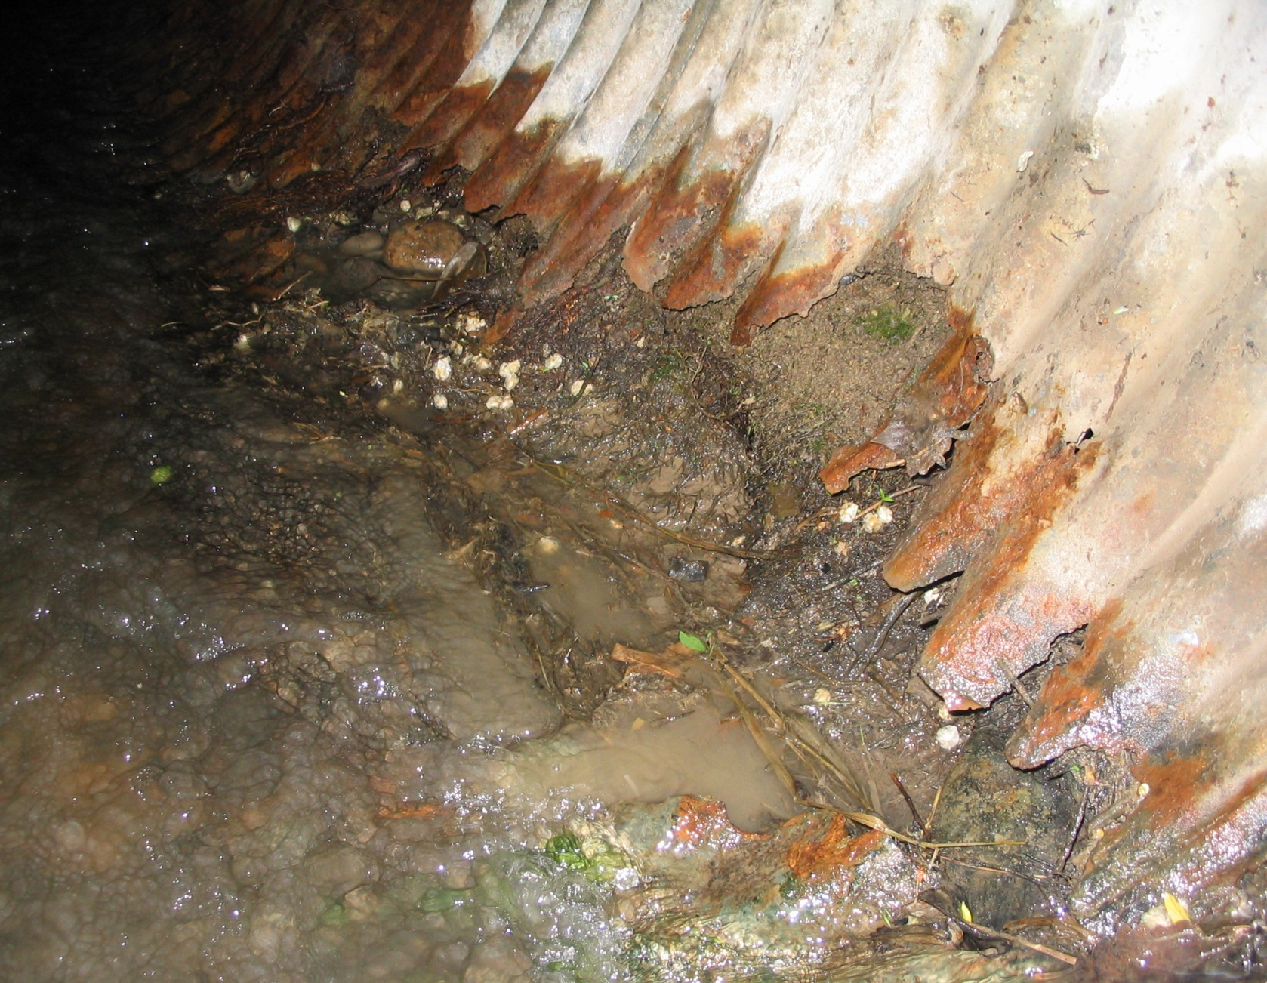
Minnesota DOT

Slide 7
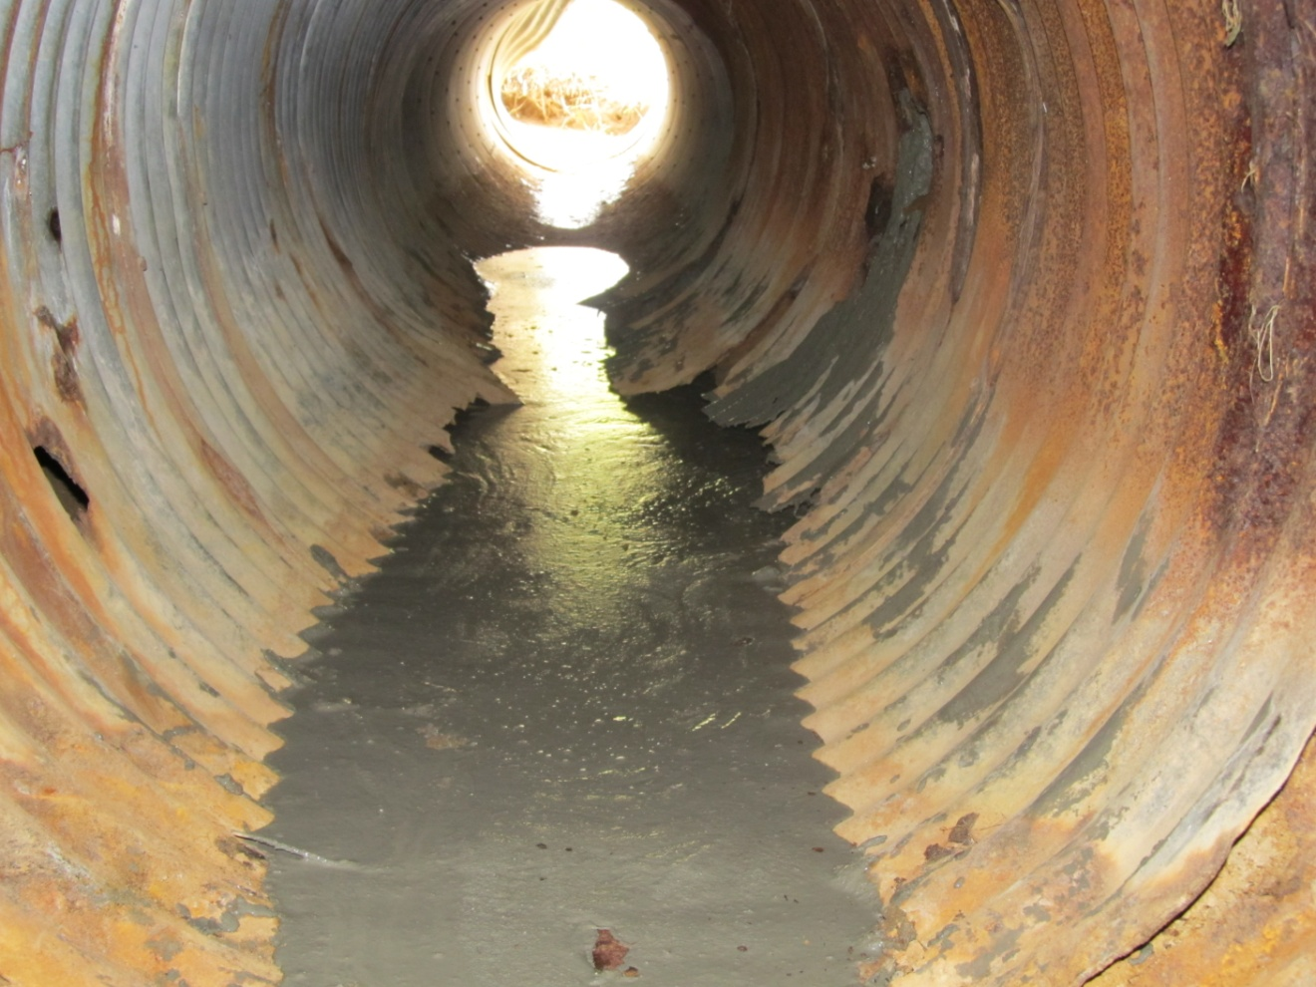

Slide 8
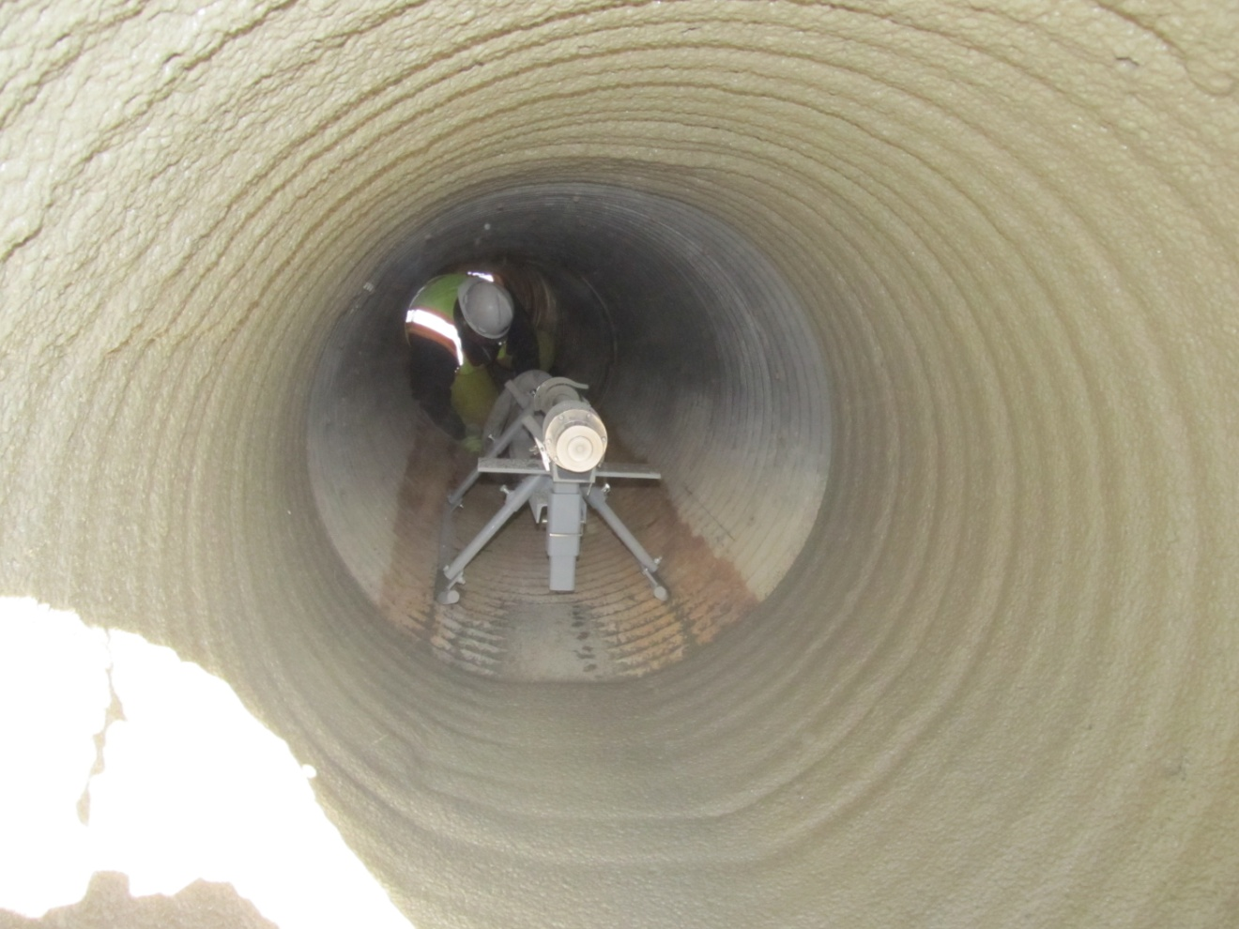
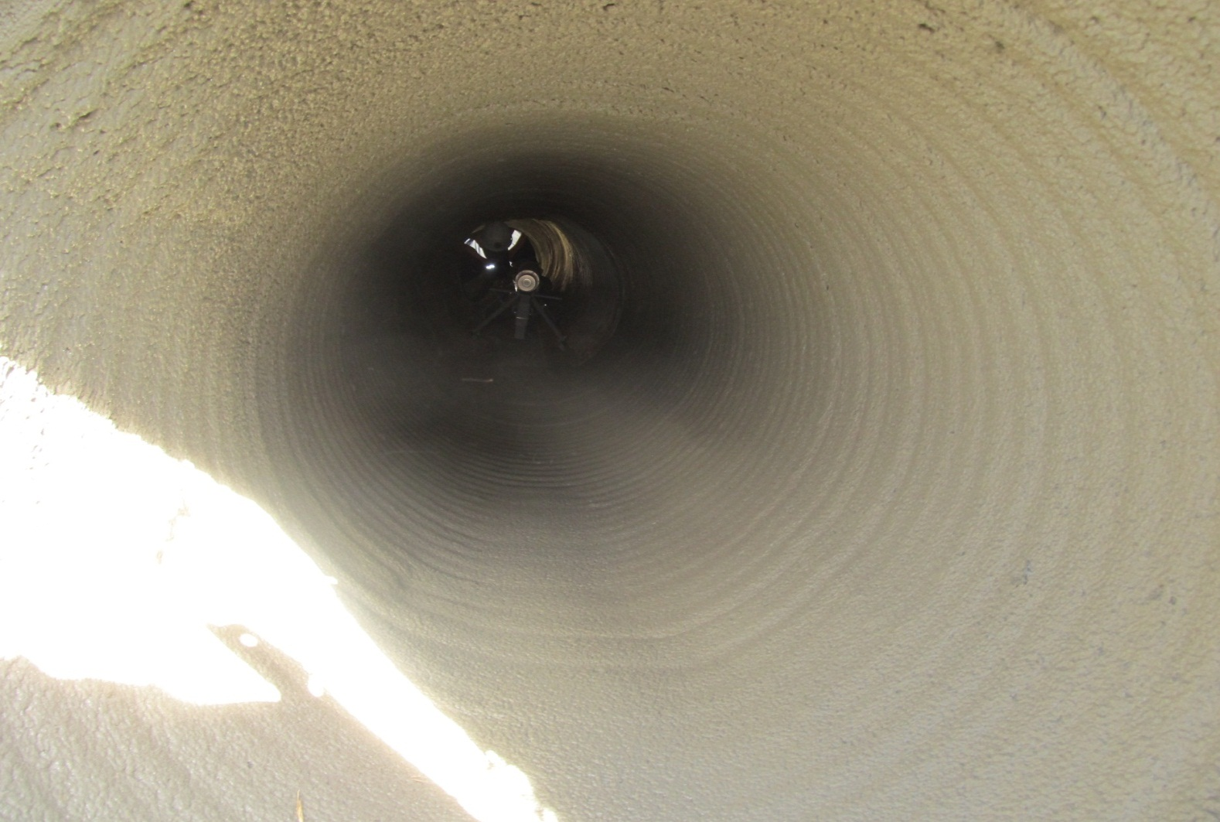

Slide 9
Minnesota DOT
Before
After

Slide 10
Clay County, Florida
When Tropical Storm Faye blew across Florida in 2008, stormwater rushed through one of the corrugated steel culvert pipes under State Road 16 in Clay County and began to draw the surrounding soil into the pipe.
"It created a void along the side of the road about 10 feet deep and 20 feet across. You could have put a couple of minivans in this hole," says Spencer Townsend, project manager for the Clay and Nassau counties local sites for Transfield Services North America.

Slide 11
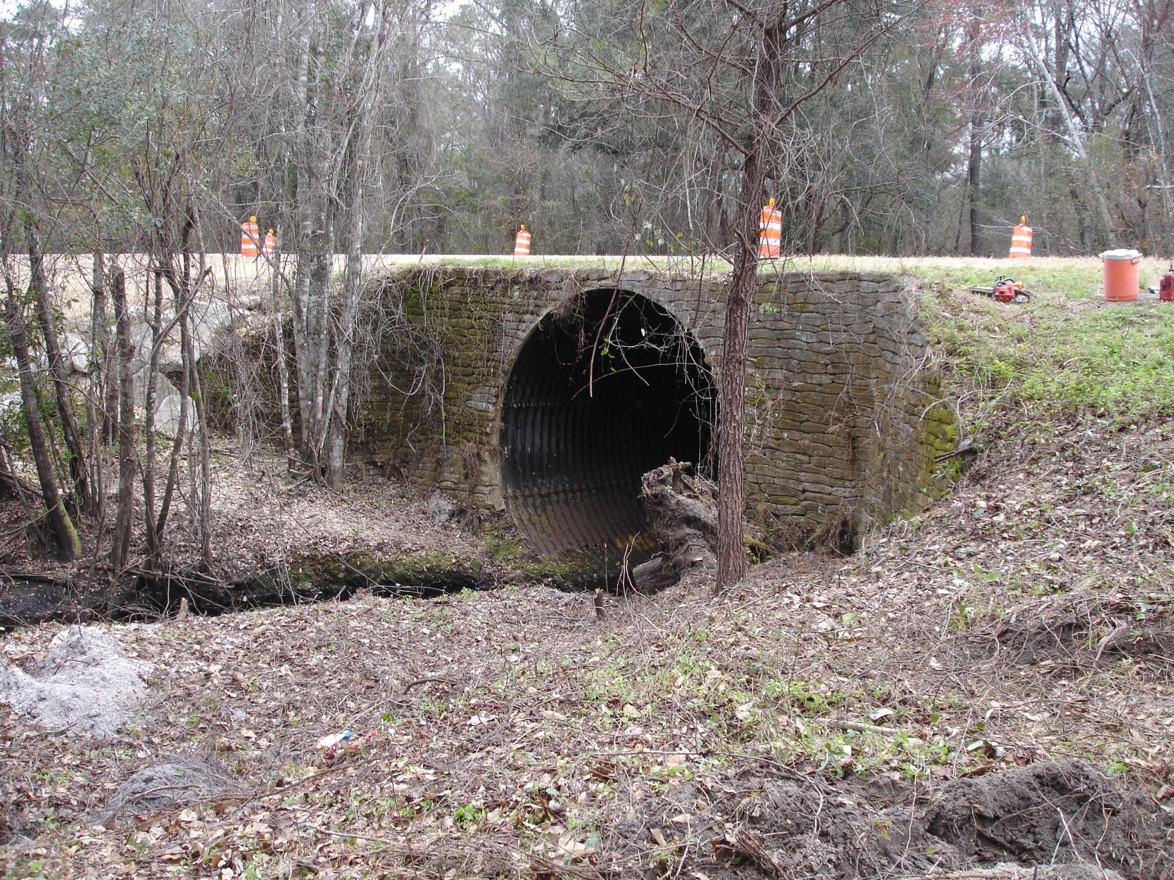
Clay County, Florida

Slide 12
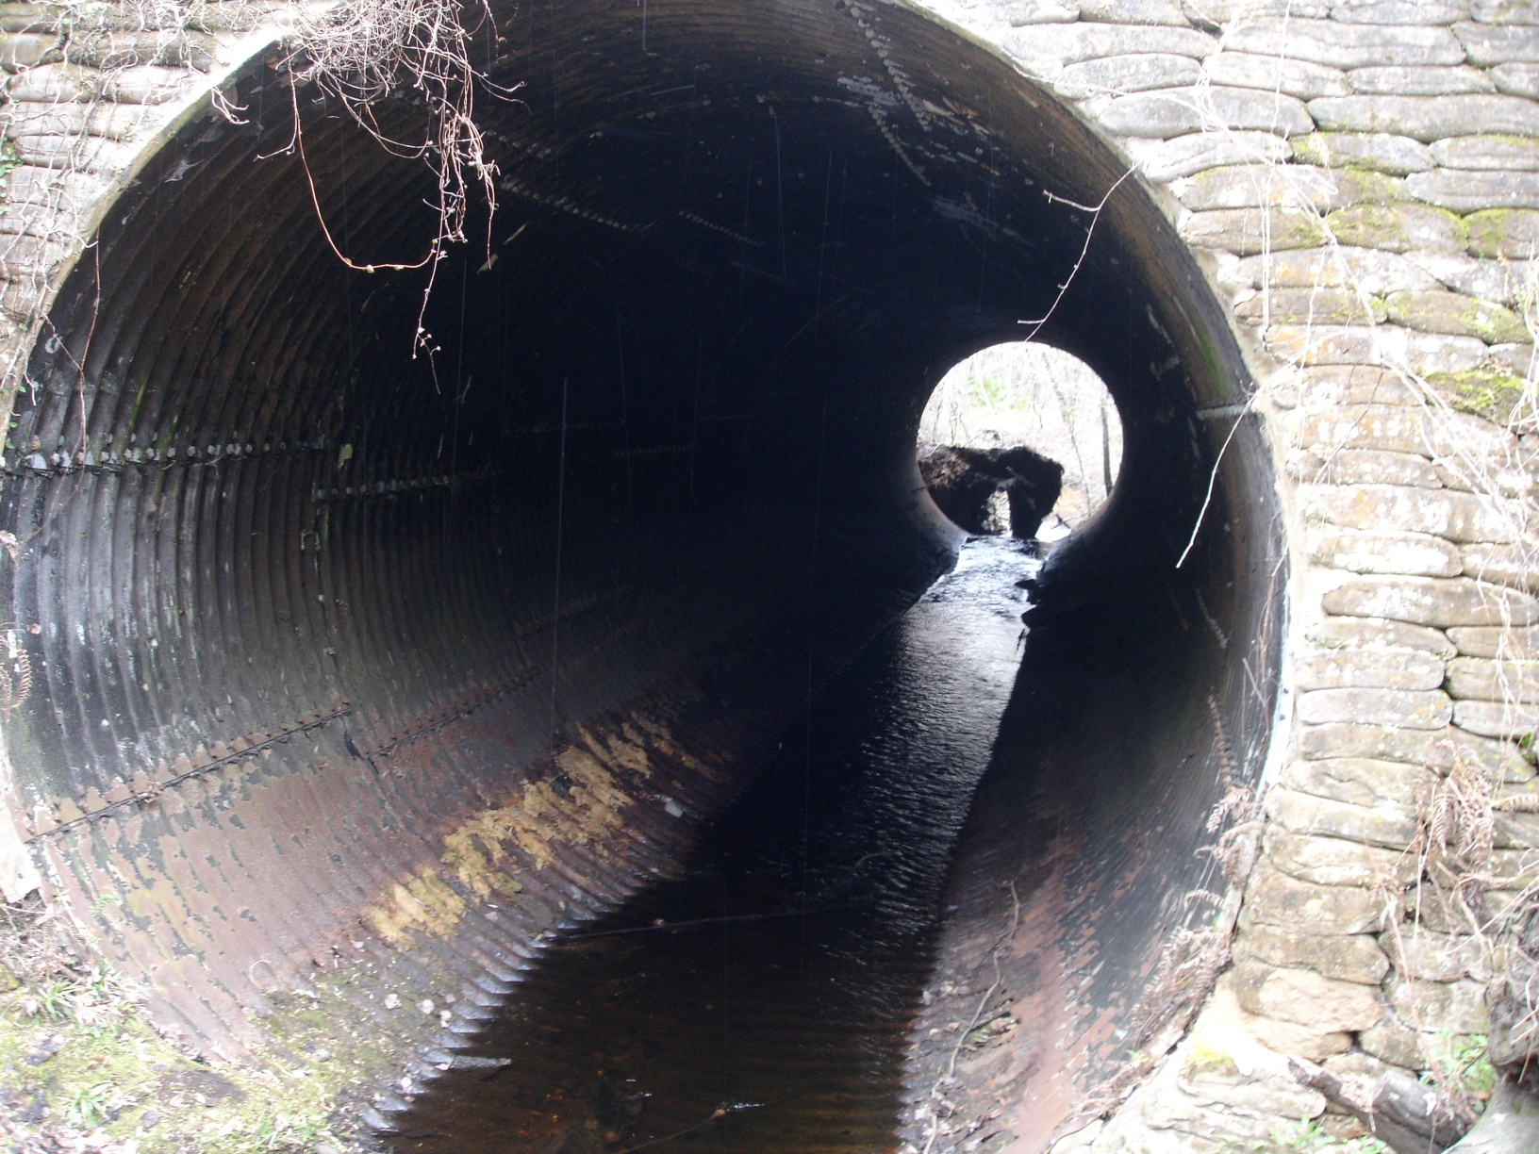
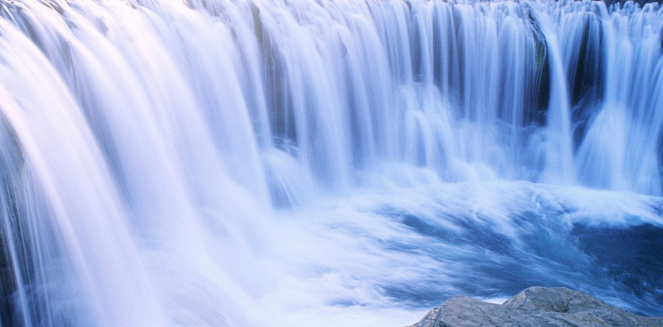

Slide 13
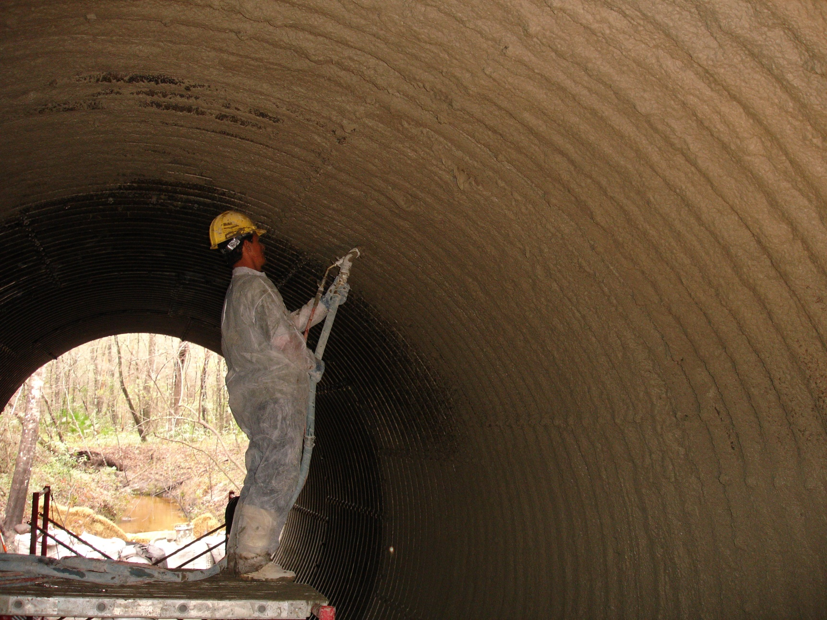

Slide 14
Clay County, Florida
Before
After

Slide 15
Sabine River Authority
Article- Stormwater magazine July/August 2011
The Sabine River Authority (SRA) was created in 1949 to equitably distribute the waters of the Sabine River and its tributaries. As part of this distribution, “We provide surface water to eleven industrial customers, such as Conoco and Louisiana Pigment, for cooling and processing,” says SRA Facility Manager Mike Carr.

Slide 16
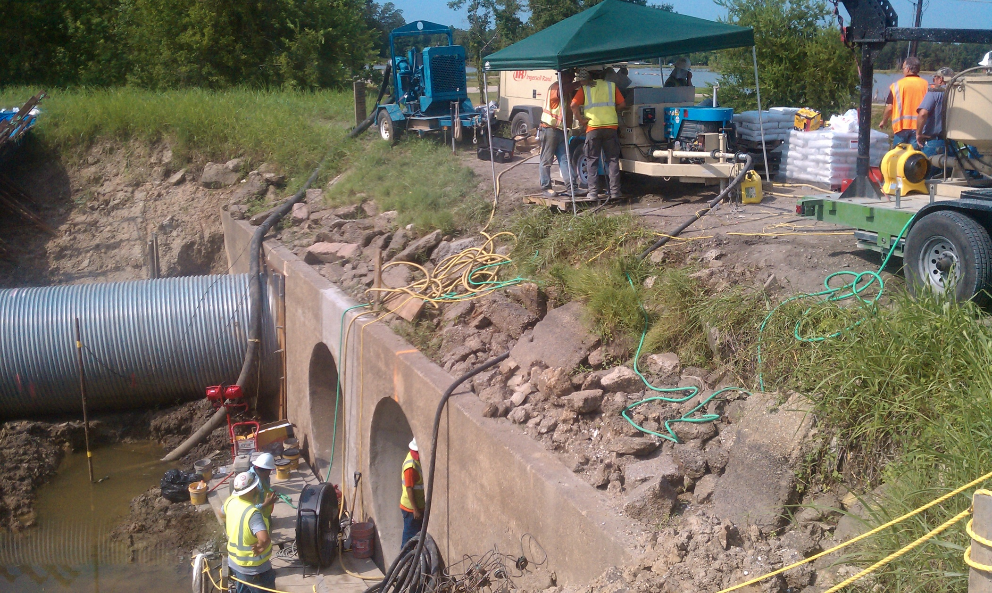

Slide 18
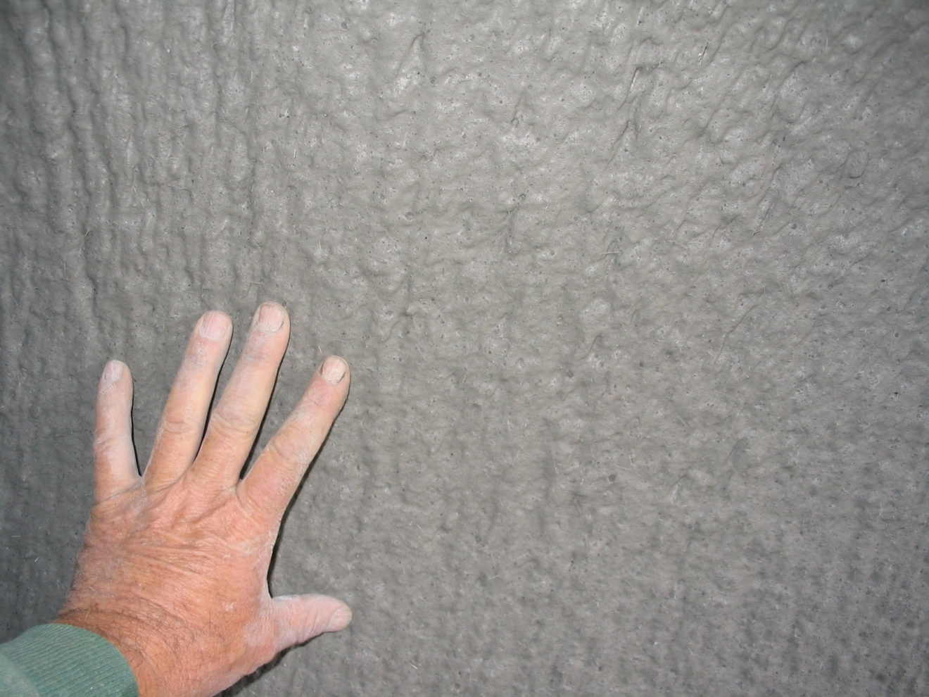

Slide 19
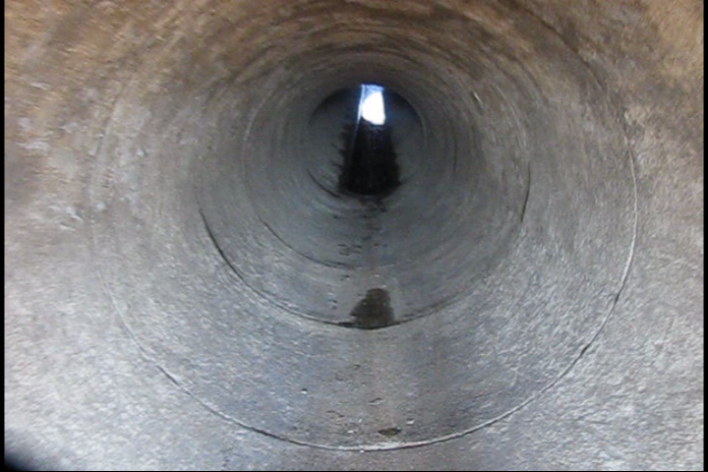
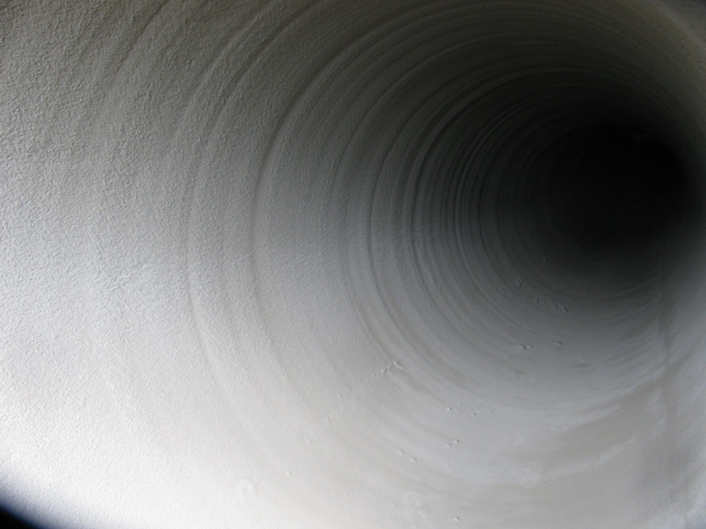
Sabine River Authority
Before
After

Slide 20
Warner Robins, Georgia
Warner Robins, Georgia, is a military town named in honor of Brigadier General Augustine Warner Robins. The city is built around Robins Air Force Base, Georgia’s largest employer.
The military background has had consequences for Warner Robins’ infrastructure. Rapid wartime expansion meant that sewers and other assets went in quickly, with relatively little planning or inspection. As a result, “We have a lot of older corrugated metal pipe (CMP) storm sewer, even under roads,” according to Storm water Management Technician Krag Woodyard. As a result (and also due to EPA mandates) the city is now struggling with major rehabilitation challenges.

Slide 21
Warner Robins, Georgia
Before
After

Slide 22
Atlantic Beach
Article- Stormwater Solutions July/August 2011
Atlantic Beach is a coastal community of 13,000 people in Duval County, Florida. As the name implies, it has a beach and the nearby ocean affects every aspect of life, including the infrastructure. Atlantic Beach’s biggest subdivision, built in the early 1960s, didn’t really take that into account.

Slide 23
Atlantic Beach, FL
Before
After

Slide 24
West Lake, Ohio
Article- UCT magazine
The City of Westlake, Ohio, got an interesting ‘wake up call’ in 2006, when a sanitary sewer interceptor line in nearby City of Lorain failed dramatically. “It forced the evacuation of several dozen homes for months,” says Westlake Director of Engineering Robert P. Kelly, PE, “and we realized we'd better take a closer look at our system.” Honorable mention for Trenchless Technology Project of the Year City of Westlake, Ohio.

Slide 25
West Lake, Ohio
Before
After
Honorable mention for Trenchless Technology project of the Year City of Westlake

Slide 26
Design Life
Notes:
Confirm the manufacturer is compliant with astm and third party testing

Slide 27
Why CCCP?
1 No-Dig -- No Traffic Control – No Street Repair
Cost Effective for Both Reinforced Concrete(RCP) and Corrugated Metal Pipe(CMP)
3 Improves Hydraulics of Corrugated Metal Pipe
Greater Abrasion Resistance then Poly Pipe or Cured In Place Liners
5 75 – 100 Year Design Life

Slide 28
Questions?

